Slide 1


Lincoln Diocesan Board of Education Vision
Collective Worship 2023
Secondary
‘Believing we are called into fellowship with God who seeks the flourishing of all, we aspire to strengthen our school communities with wisdom, knowledge and understanding.
Through partnerships firmly rooted in Christian hope and in the love of God, we empower all in our Church school family to love one another with humility, justice and kindness.’
Called Aspirational Rooted Empowering
C A R E

Slide 2
How to use this PowerPoint
These Collective Worship Plans have been created to help school communities understand the LDBE Vision 2023. It shows the theologically underpinning of the story of Moses as well as the other biblical verses linked with the different elements of the vision and C.A.R.E.
The theme of the worship and the biblical background should not be changed, however all the activities and resources can be adapted or changed to suit the needs of your school context, age of the young people and how you deliver your Collective Worship.
Each worship has a mixture of the following sections:
Preparations for the leader of the worship
Quote to discuss
Biblical teaching
Activity/Information that links to the theme
What now? - how the theme can impact outside of the worship
Prayer
Under many of the slides there are accompanying notes. Please print the documents with notes pages to use them.
Each worship is not a set amount of time, you can structure it in a way that works for your school and spend as little or as long as you see fit, you can also add to it using other resources.
If you have any questions please contact lynsey.norris@lincoln.anglican.org

Slide 3

Key Concept 3

Slide 4
Before the Worship
Background Information | Moses was empowered by God to undertake this challenging task and be an agent of change.
Biblical Teaching | Micah 6:8 He has shown you, O mortal, what is good. And what does the Lord require of you? To act justly and to love mercy and to walk humbly with your God. Micah 6:8 connects faith with actions, the care for those in need with a Christian’s walk with God. To “walk humbly with God” is the basis for loving mercy and doing justice To “love mercy” can be translated as love kindness, God wants us to be drawn to mercy—having compassion for those in need. Moses did this by obeying God and setting the Israelites free. We can do this with how we treat one another and how we can empower those around us
Background of the Concept and Personal Preparation | Quote: “Start where you are. Use what you have. Do what you can.” Arthur Ashe Listen: In preparation listen to The Justice Song (Global Edition) https://www.youtube.com/watch?v=yxTGsxxX_fA or Act Justly https://www.youtube.com/watch?v=dk7llf2LkKc Discover: What does it mean for you to empower someone? How do you live your life so that your belief system resonates with your actions? Do the answer to your previous two questions link with Micah 6:8 at all?

Slide 5
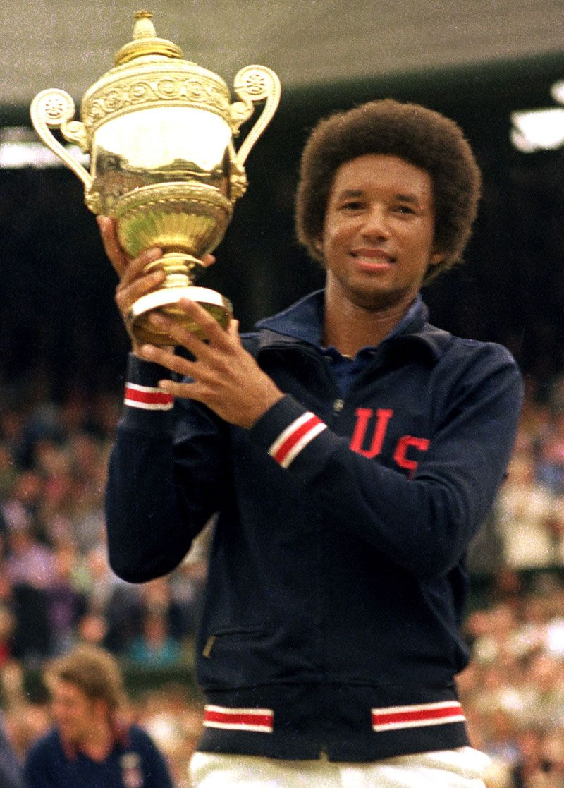
Quote
“Start where you are. Use what you have. Do what you can.”
Arthur Ashe
American Tennis Player
Civil Rights Activist
What does this quote mean?
Arthur was a Civil Rights Activist, why do you think this quote would be important to him in that role?

Slide 6
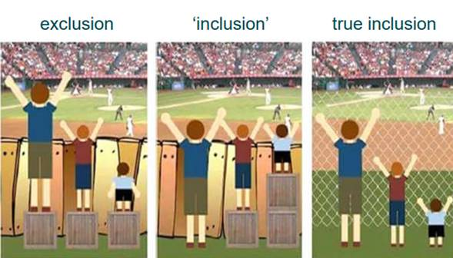
Notes:
What does this picture mean to your students?
Discuss the difference between the images – draw out the idea that by how we notices and respond to situations means we can remove barriers so that everyone can have the same access to what they need for life to be fair. Can they think of examples when people don’t have a fair start compared to everyone else, or what barriers people have in life? How can those barriers need to be removed?
e.g. disability, poverty, refugees, race, gender (At this point you can link it to the work you have done on protected characteristics)

Slide 7
What does the Bible say?
Micah 6:8
He has shown you, O mortal, what is good.
And what does the Lord require of you?
To act justly and to love mercy
and to walk humbly with your God.
What does it mean to act justly and love mercy?
Notes:
Sometimes mercy is translated at kindness

Slide 8
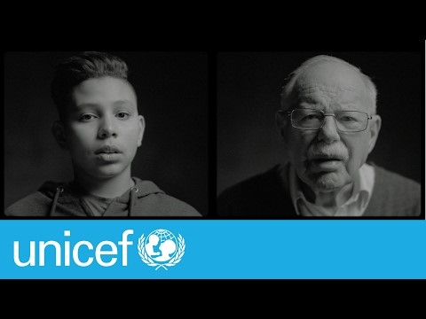
What about today?
How can we act justly and love mercy?
Refugees
Notes:
At this point any area of disadvantage can be chosen to look at. There are two examples on these slides, however please pick what is most suitable for your school context. The following website has examples of discrimination in schools that could be used and adapted for discussion https://www.equalityhumanrights.com/en/secondary-education-resources/useful-information/equality-case-studies
Show some examples and ask, how do we act justly and love mercy

Slide 9
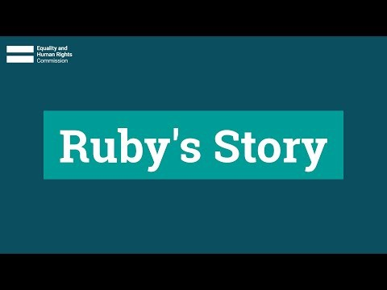
What about today?
How can we act justly and love mercy?
Race Discrimination
Notes:
What should have happened, how could the school have acted justly and loved mercy

Slide 10
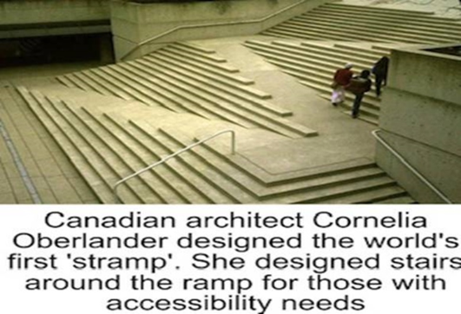
What about today?
How can we act justly and love mercy?
Disability
.
Notes:
Use this image to stimulate discussion – especially around inclusion and not separating people out into disabled and disabled.
Link to act justly and love mercy

Slide 11
What now?
Refugees by Brian Bilston
They have no need of our help So do not tell me These haggard faces could belong to you or me Should life have dealt a different hand We need to see them for who they really are Chancers and scroungers Layabouts and loungers With bombs up their sleeves Cut-throats and thieves They are not Welcome here We should make them | Go back to where they came from They cannot Share our food Share our homes Share our countries Instead let us Build a wall to keep them out It is not okay to say These are people just like us A place should only belong to those who are born there Do not be so stupid to think that The world can be looked at another way (now read from bottom to top)

Slide 12
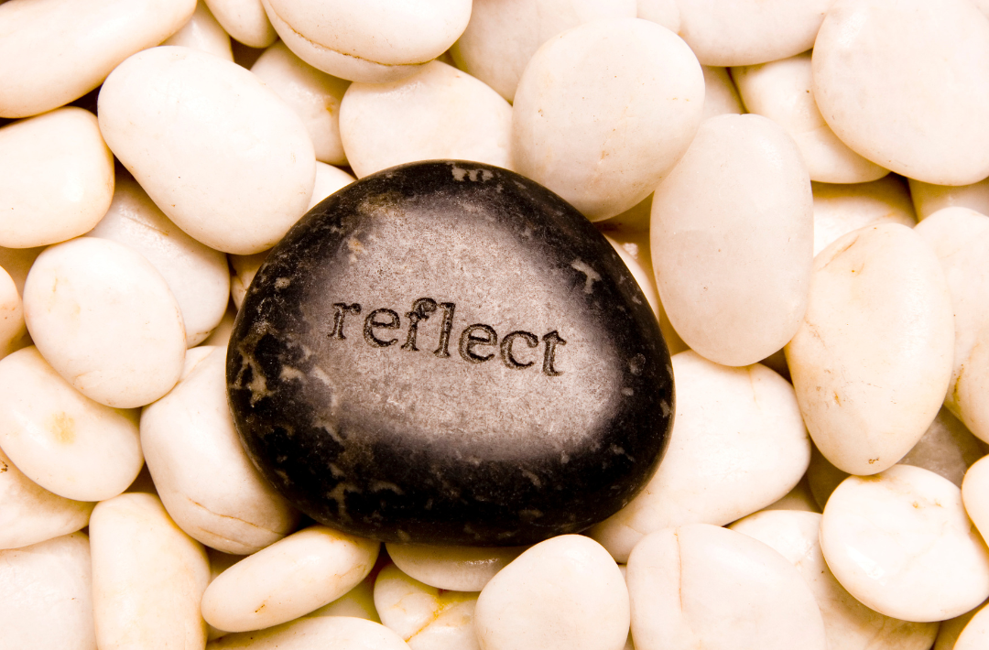
What now?
Do I always act justly and love mercy?
Are there areas in life I need to act better or show more compassion?
Are there people I need to apologise to because I have not acted justly towards them or shown them kindness?
What am I going to do differently from
today?
Notes:
Students to have some personal reflection time
Perhaps play The Justice Song (Global Edition) https://www.youtube.com/watch?v=yxTGsxxX_fA or Act Justly https://www.youtube.com/watch?v=dk7llf2LkKc

Slide 13
Prayer
Dear God,
Thank you that you love all of us and
we are all created in your image.
Please help us to act justly, love mercy,
and walk humbly.
Help our actions show your love to everyone,
thank you for your love
Amen

