Slide 1


Lincoln Diocesan Board of Education Vision
Collective Worship 2023
Secondary
‘Believing we are called into fellowship with God who seeks the flourishing of all, we aspire to strengthen our school communities with wisdom, knowledge and understanding.
Through partnerships firmly rooted in Christian hope and in the love of God, we empower all in our Church school family to love one another with humility, justice and kindness.’
Called Aspirational Rooted Empowering
C A R E

Slide 2
How to use this PowerPoint
These Collective Worship Plans have been created to help school communities understand the LDBE Vision 2023. It shows the theologically underpinning of the story of Moses as well as the other biblical verses linked with the different elements of the vision and C.A.R.E.
The theme of the worship and the biblical background should not be changed, however all the activities and resources can be adapted or changed to suit the needs of your school context, age of the young people and how you deliver your Collective Worship.
Each worship has a mixture of the following sections:
Preparations for the leader of the worship
Quote to discuss
Biblical teaching
Activity/Information that links to the theme
What now? - how the theme can impact outside of the worship
Prayer
Under many of the slides there are accompanying notes. Please print the documents with notes pages to use them
Each worship is not a set amount of time, you can structure it in a way that works for your school and spend as little or as long as you see fit, you can also add to it using other resources.
If you have any questions please contact lynsey.norris@lincoln.anglican.org

Slide 3

Key Concept 3

Slide 4
Before the Worship
Background Information | Just as the burning bush was rooted in holy ground, our schools are rooted with a Christian foundation, through Christian hope and the love of God
Biblical Teaching | Colossians 2:6-7 So then, just as you received Christ Jesus as Lord, continue to live your lives in him, rooted and built up in him, strengthened in the faith as you were taught, and overflowing with thankfulness. Church schools are rooted in partnerships (with the LDBE, one another, churches and families) rooted in Christian hope and rooted in the love of God.
Background of the Concept and Personal Preparation | Quote: ‘To be rooted is perhaps the most important and least recognized need of the human soul.’ Simone Weil Discover: What are you rooted in, what keeps you from falling over, what feeds you, what supports you? Explore: Find out the importance of being rooted in Jesus for Christians https://www.jcblog.net/colossians/2/6-7-just-as-you-received-christ-continue-to-live Listen: As you prepare listen to the song ‘Cornerstone’ which speaks of Jesus being the cornerstone in life and a Christian’s life being built on him. Historically, the cornerstone was the most important part of any building. The total weight of an edifice rested on this particular stone, which, if removed, would collapse the whole structure. The cornerstone was also the key to keeping the walls straight https://www.youtube.com/watch?v=izrk-erhDdk

Slide 5
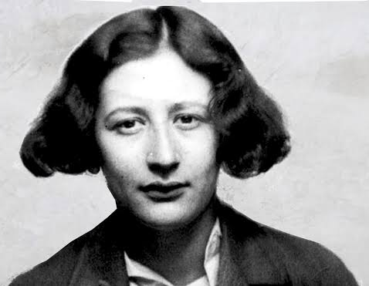
Quote
“To be rooted is perhaps the most important and least recognized need of the human soul.”
Simone Weil
French Philosopher
What does this quote mean?
Do you agree?
Do you feel rooted somewhere?

Slide 6

Notes:
Watch: The video explains the function of roots https://www.youtube.com/watch?v=_3Ofe--FUv8
Ask pupils to take notes of what the roots do and why they are important
They are an anchor
Keep the plant in place so it doesn’t fall over
It allows nutrients to come from the soil into the plant so the plant can survive
The nutrients can be stored for later or used straight away
They give support
They help it plant grow

Slide 7
Discuss
Do you know the roots of this school?
What does it mean to be a Church of England school?
How does our school keep us anchored?
How does our school help me stand tall and not fall over?
What ‘nutrients’ does our school give us so we can survive?
How does our school give everyone support?
How does our school help us grow?
Notes:
This is a good opportunity to discuss how Church of England schools are different to non church of England schools and what this menas for students.
This is also a good opportunity to talk about the school vision and values and how they help root us.

Slide 8


What does the Bible say?
Colossians 2:6-7
So then, just as you received Christ Jesus as Lord, continue to live your lives in him, rooted and built up in him, strengthened in the faith as you were taught, and overflowing with thankfulness.
Christians believe they should root themselves in Jesus
How do they do this?

Slide 9
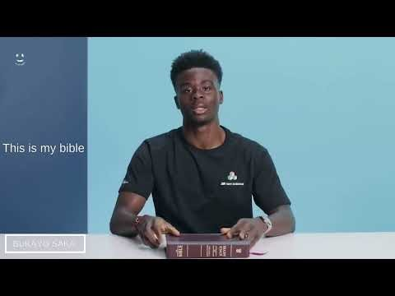

What about today?
Bukayo Saka plays as a midfielder for Premier League club Arsenal and the England national team.
Notes:
Watch what Bukayo Saka says about rooting his faith in reading the bible
How else might Christians root their life in Jesus? prayer, read bible, go to church, meet with other Christians

Slide 10
What now?
What do you root your life in?
Your personal values are a central part of who you are – and who you want to be.
By becoming more aware of these vital factors in your life, you can use them as a guide to make the best choice in any situation.
Some of life's decisions are really about determining what you value most. When many options seem reasonable, you can rely on your values to point you in the right direction.
When how you live matches your values, life is usually good. When your existence doesn't align with your personal values, that's when things feel... wrong and you can feel unhappy.
Notes:
Take time with the students to work out what their values are
Here are some steps to help - taken from https://www.mindtools.com/a5eygum/what-are-your-values
Step 1: Identify the times when you were happiest
Find examples from both your career and personal life. This will ensure some balance in your answers.
What were you doing?
Were you with other people? Who?
What other factors contributed to your happiness?
Step 2: Identify the times when you were most proud
Use examples from your career and personal life.
Why were you proud?
Did other people share your pride? Who?
What other factors contributed to your feelings of pride?
Step 3: Identify the times when you were most fulfilled and satisfied
Again, use both work and personal examples.
What need or desire was fulfilled?
How and why did the experience give your life meaning?
What other factors contributed to your feelings of fulfillment?
Step 4: Determine your top values, based on your experiences of happiness, pride, and fulfillment
Why is each experience truly important and memorable? Use the following list of common personal values to help you get started – and aim for about 10 top values. (As you work through, you may find that some of these naturally combine. For instance, if you value philanthropy, community, and generosity, you might say that service to others is one of your top values.)

Slide 11
Prayer
Dear God,
Thank you for Jesus,
Help us to be rooted in His love,
Help us to stay firmly connected to you so we can grow in faith.
Help us understand how important that is.
Thank you for your love.
Amen

