Slide 1


Lincoln Diocesan Board of Education Vision
Collective Worship 2023
Secondary
‘Believing we are called into fellowship with God who seeks the flourishing of all, we aspire to strengthen our school communities with wisdom, knowledge and understanding.
Through partnerships firmly rooted in Christian hope and in the love of God, we empower all in our Church school family to love one another with humility, justice and kindness.’
Called Aspirational Rooted Empowering
C A R E

Slide 2
How to use this PowerPoint
These Collective Worship Plans have been created to help school communities understand the LDBE Vision 2023. It shows the theologically underpinning of the story of Moses as well as the other biblical verses linked with the different elements of the vision and C.A.R.E.
The theme of the worship and the biblical background should not be changed, however all the activities and resources can be adapted or changed to suit the needs of your school context, age of the young people and how you deliver your Collective Worship.
Each worship has a mixture of the following sections:
Preparations for the leader of the worship
Quote to discuss
Biblical teaching
Activity/Information that links to the theme
What now? - how the theme can impact outside of the worship
Prayer
Under many of the slides there are accompanying notes. Please print the documents with notes pages to use them.
Each worship is not a set amount of time, you can structure it in a way that works for your school and spend as little or as long as you see fit, you can also add to it using other resources.
If you have any questions please contact lynsey.norris@lincoln.anglican.org

Slide 3

Key Concept 2

Slide 4
Before the Worship
Background Information | Moses actively sought to address injustice With God’s support, Moses actively sought to address injustice. In this story we see God and Moses aspire for something better for the Israelites due to the oppression they were facing
Biblical Teaching | Exodus 3:3 – 12 Moses and The Burning Bush The LORD said, “I have indeed seen the misery of my people in Egypt. I have heard them crying out because of their slave drivers, and I am concerned about their suffering. So, I have come down to rescue them from the hand of the Egyptians and to bring them up out of that land into a good and spacious land, a land flowing with milk and honey We aspire for our school communities and everyone in them to be strong. This verse speaks of how we can help one another along that journey. The DBE vision speaks of doing this with wisdom, knowledge and understanding.
Background of the Concept and Personal Preparation | Bible Background: Throughout the Old and New Testament, there is a clear call to do justice “Give justice to the weak and the fatherless; maintain the right of the afflicted and the destitute,” (Psalm 82:3). “Learn to do good; seek justice, correct oppression; bring justice to the fatherless, and please the widow's cause,” (Isaiah 1:17) Current work: Throughout history Christians have fought against injustice. Below are some current organisations working for change. Look at the work of One by One who are fight Child exploitation and slavery across the world https://onebyone.net/ Look at the work of A Rocha. They work to protect and restore the natural world and equip Christians around the world in how to care for the environment. https://arocha.org/en/ Look at the work of Ben Lindsay. Ben Lindsay OBE is founder of Power the Fight, launched in 2019, Power the Fight is an award-winning charity which tackles violence affecting young people, he also wrote the book We need to talk about Race https://benlindsay.co.uk/ Listen: As you prepare listen to the song Amazing Grace and find out about the story behind the hymn. Modern version by Chris Tomlin https://www.youtube.com/watch?v=3MZgXXUW08Q Tradition version by El Divo https://www.youtube.com/watch?v=GYMLMj-SibU History behind Amazing Grace and the writer John Newton – from slave trader to activist https://en.wikipedia.org/wiki/Amazing_Grace

Slide 5
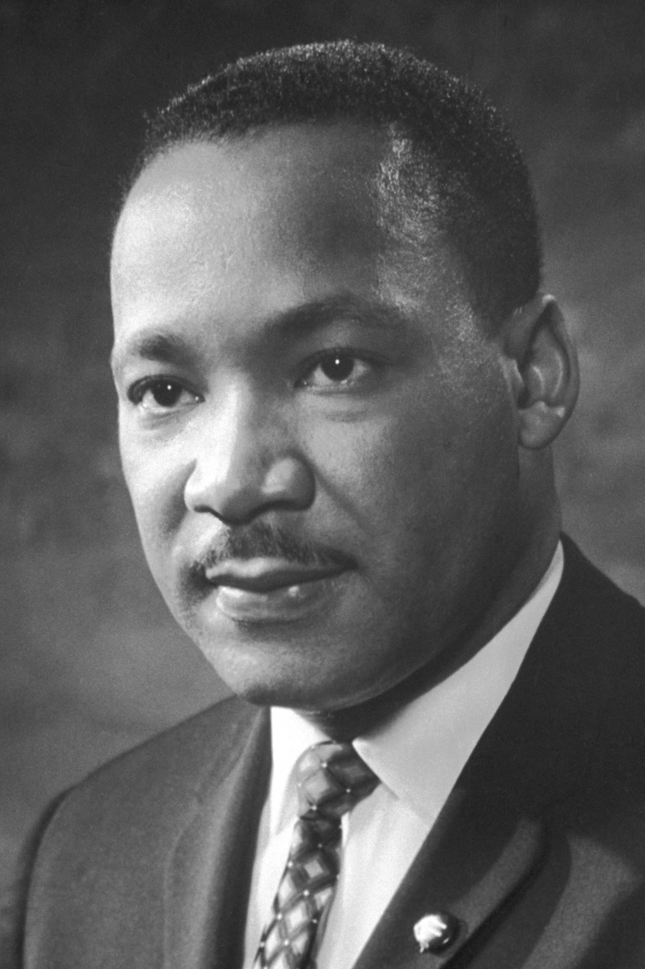
Quote
“Injustice anywhere is a threat to justice everywhere.”
Martin Luther King Jr
What does this quote mean?
Do you agree?
Notes:
Full quote "Injustice anywhere is a threat to justice everywhere. We are caught in an inescapable network of mutuality, tied in a single garment of destiny. Whatever affects one directly, affects all indirectly."

Slide 6
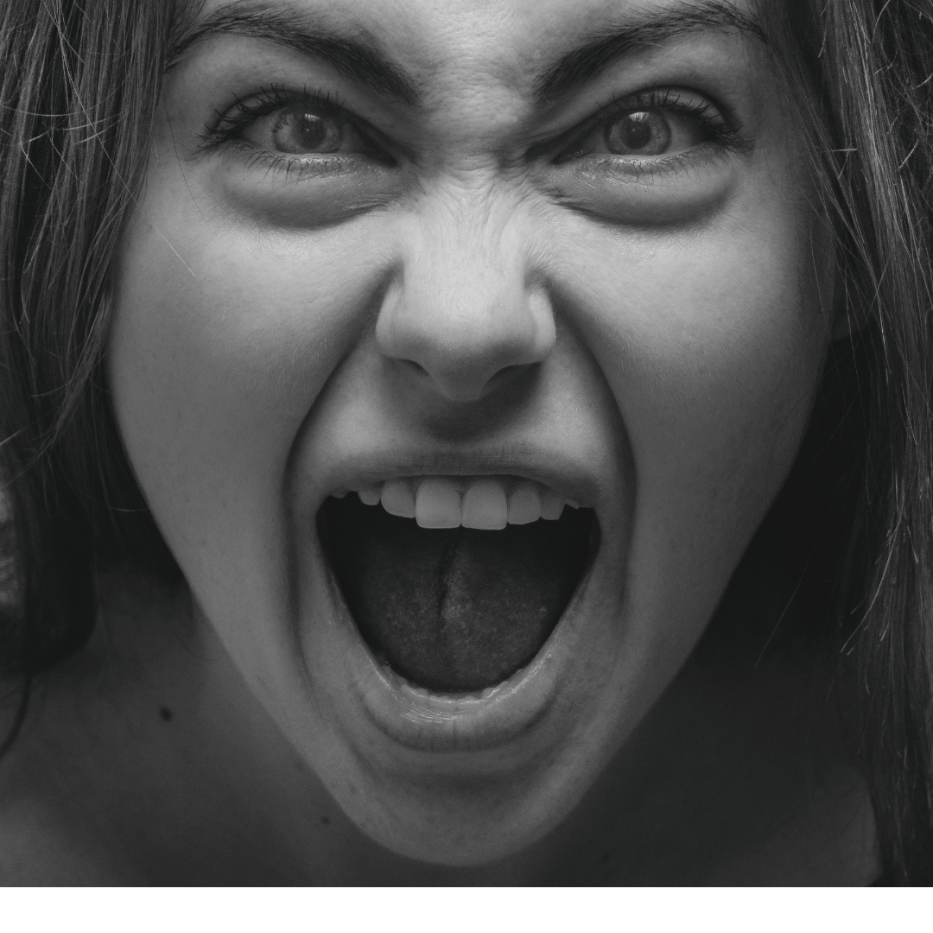
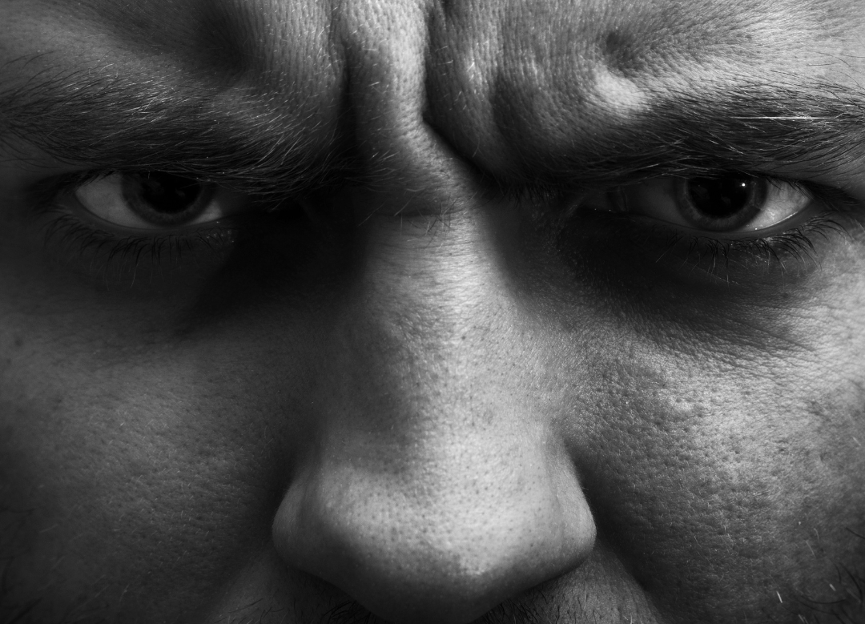
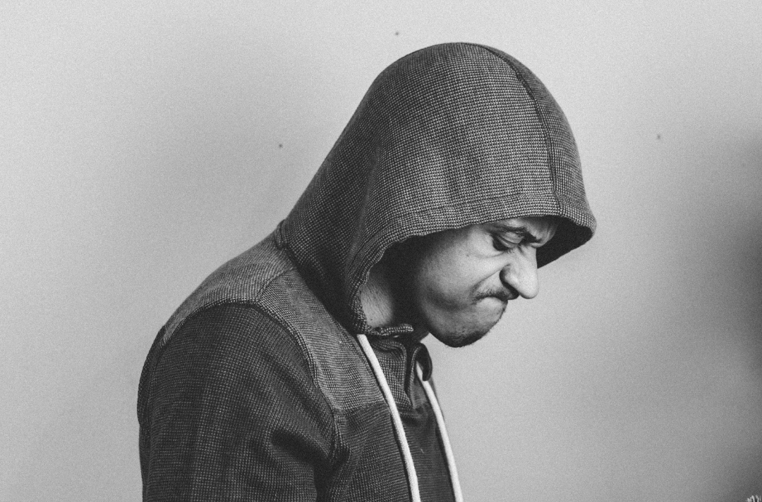
That’s not fair!!!
That makes me so angry!!!!
They can’t do that!!!
Notes:
What makes them angry?
What happens in life that they think is unfair?
Link this to the last worship about social issues
Link this to injustice

Slide 7

What does the Bible say?
“Give justice to the weak and the fatherless; maintain the right of the afflicted and the destitute,” (Psalm 82:3).
“Learn to do good; seek justice, correct oppression; bring justice to the fatherless, and please the widow's cause,” (Isaiah 1:17)
Notes:
If everyone followed these verse how different would like be
Imagine they have the power to be able to make a ‘New World’, whilst considering three questions:
1. What would they keep the same?
2. What would they change?
3. What rules would they create?

Slide 8

What about today?
Notes:
Explain how weighing scales like the ones on the slide work
Explain to the pupils - some people are treated utterly unfairly in life, scales are often used as a symbol of justice. Let’s have a look at the case studies (at the end of the PowerPoint feel free to adapt or use your own). When a case study is read out as them to imagine a weight has been put on one side – ask them what could be done for those situations to be changed – this will add balance to the scales . Talk about balance and what can be done to balance out and change injustice. (adapted from www.prayerspacesinschools.com)

Slide 9
What now?
Throughout history Christians have fought against injustice.
The song Amazing Grace was written by John Newton, a slave trader that was convicted by what he had done and turned to God.
The first verse talks about how he changes his life to make a difference.
Why not research some Christians organisations and individuals that fight injustice today and see what motivates them.
Amazing grace how sweet the sound
That saved a wretch like me
I once was lost, but now I'm found
Was blind but now I see
Notes:
https://www.youtube.com/watch?v=b3NelRb1LY4
Look at the work of One by One who are fight Child exploitation and slavery across the world https://onebyone.net/
Look at the work of A Rocha. They work to protect and restore the natural world and equip Christians around the world in how to care for the environment. https://arocha.org/en/
Look at the work of Ben Lindsey. Ben Lindsay OBE is founder of Power the Fight, launched in 2019, Power the Fight is an award-winning charity which tackles violence affecting young people, he also wrote the book We need to talk about Race https://benlindsay.co.uk/

Slide 10

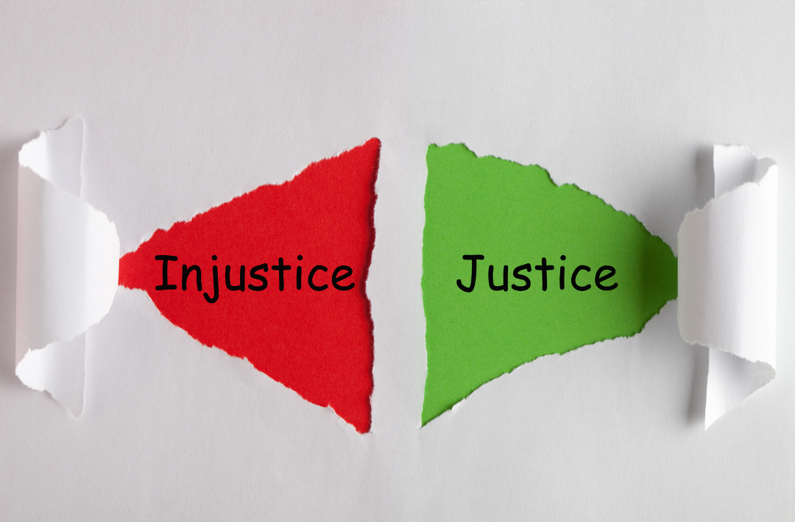
What now?
ISSUE SOLUTION
Notes:
Give children two pieces of paper, ask the children to write what injustice makes them angry on one piece of paper and a solution to that. The solution could be something they can do, someone is already doing or maybe a prayer to ask God to help those that are living under injustice.
play God of Justice by Tim Hughes as they do this https://www.youtube.com/watch?v=b3NelRb1LY4
Ideas for solutions
Research: Spend some time researching the issue of injustice to find out more about it
Action: Write a letter to your MP to express how you’d like things to change, for your issue of injustice
Research: Invite (with the help of your teachers) someone for your issue of injustice to lead a session in school
Action: Think of a way you can raise money for you issue of injustice

Slide 11
Prayer
Dear God,
Thank you that you care about everything
and everyone in the world and
you also care about when things are unjust.
We ask you to be with people that are struggling
with being treated unfairly and those that are in situations
that make their life difficult.
We ask you will help those that are most
in need in our community, across the country and the world.
Help us to make a difference in the world and
help those who are not treated fairly.
Give us wisdom to know how we can help and bring balance.
Amen

Slide 12
A young woman suffered disability discrimination when she was turned away from a beauty clinic because she was accompanied by her guide dog. The woman was 28-years old when the incident occurred. She was born with a progressive condition which limited her eyesight and had been registered blind for over 15 years. Her guide dog accompanied her everywhere. In 2015, she attended a beauty clinic in Glasgow having booked to receive a facial treatment. Arriving with her guide dog, she was told by reception staff that the dog would not be allowed into the treatment room and would need to wait outside.
Only 51 out of the 1,097 most powerful roles in the country were filled by non-white individuals in 2020, an increase of only 1.2%, or 15 people, since 2017.
There are 20,000 brick kilns in Pakistan, where adults and children are often duped into bonded labour by factory owners who give them loans. Families agree to work to pay off the debt but bosses add high interest and living expenses – making the debts impossible to pay off. Salaries for adults – who are forced to work at least 14 hours per day in brutal conditions – can be as low as $5 per day
Around 2.4 million people experienced destitution (not having the essentials to eat, stay warm and dry, and keep clean) in the UK at some point during 2019.
Girls are missing school each month, because they can’t afford sanitary products.
Period poverty places some young women at an educational disadvantage.
Source Material referenced in
accompanying Teacher PDF Pack
Community Matter ©ABBYT.

