Slide 1


Lincoln Diocesan Board of Education Vision
Collective Worship 2023
Secondary
‘Believing we are called into fellowship with God who seeks the flourishing of all, we aspire to strengthen our school communities with wisdom, knowledge and understanding.
Through partnerships firmly rooted in Christian hope and in the love of God, we empower all in our Church school family to love one another with humility, justice and kindness.’
Called Aspirational Rooted Empowering
C A R E

Slide 2
How to use this PowerPoint
These Collective Worship Plans have been created to help school communities understand the LDBE Vision 2023. It shows the theologically underpinning of the story of Moses as well as the other biblical verses linked with the different elements of the vision and C.A.R.E.
The theme of the worship and the biblical background should not be changed, however all the activities and resources can be adapted or changed to suit the needs of your school context, age of the young people and how you deliver your Collective Worship.
Each worship has a mixture of the following sections:
Preparations for the leader of the worship
Quote to discuss
Biblical teaching
Activity/Information that links to the theme
What now? - how the theme can impact outside of the worship
Prayer
Under many of the slides there are accompanying notes. Please print the documents with notes pages to use them.
Each worship is not a set amount of time, you can structure it in a way that works for your school and spend as little or as long as you see fit, you can also add to it using other resources.
If you have any questions please contact lynsey.norris@lincoln.anglican.org

Slide 3
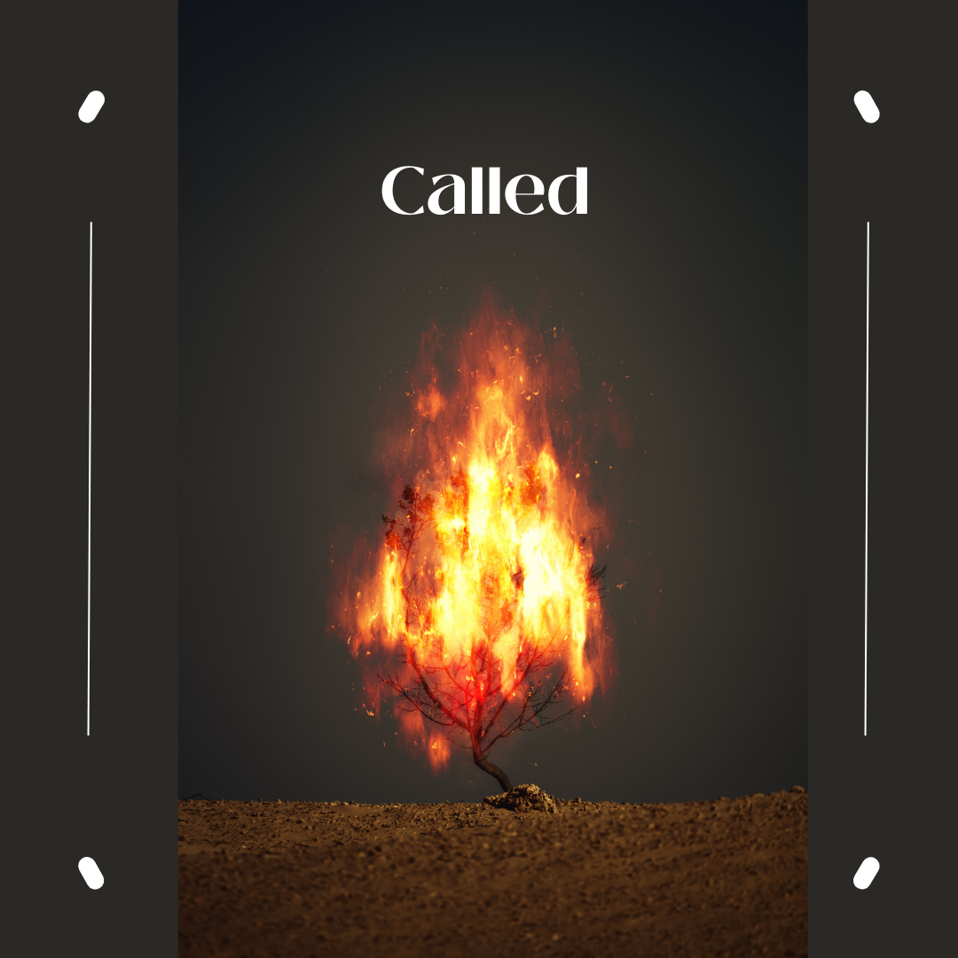
Key Concept 1

Slide 4
Before the Worship
Background Information | Moses has an encounter with a living God. God calls him by name and for a community to go to Pharaoh to ask him to free the Jewish slaves. He asks ‘who am I?’ and questions his own ability to do this task In life today, God calls us into fellowship with him through Jesus so we can flourish
Biblical Teaching | Exodus 3:3 – 12 Moses and The Burning Bush So now, go. I am sending you to Pharaoh to bring my people the Israelites out of Egypt.
Background of the Concept and Personal Preparation | Quote: ‘Thus, when you wake up in the morning, called by God to be a self again, if you want to know who you are, watch your feet. Because where your feet take you, that is who you are.’ Frederick Buechner Read: Read Acts 9:1-19 When God called Saul to be Paul and change his life dramatically Watch: This YouTube clip is about Darrell a man in prison and how he felt God called him into fellowship with him and how his life changed https://www.youtube.com/watch?v=WnL6HOSZ8hk&list=PLV4H76BPzCKVoVu2mfLKUCjDRss2wys52&index=2 Listen: Oceans https://www.youtube.com/watch?v=6GGFb6LcX3U This song is an encouragement that whatever God calls us to he is with us. Prayer: Dear God, thank you, you have given us all unique gifts and talents and that I was born in this time for a purpose. Help me to know what you have called me to, so I can make a difference where you have placed me. Amen

Slide 5
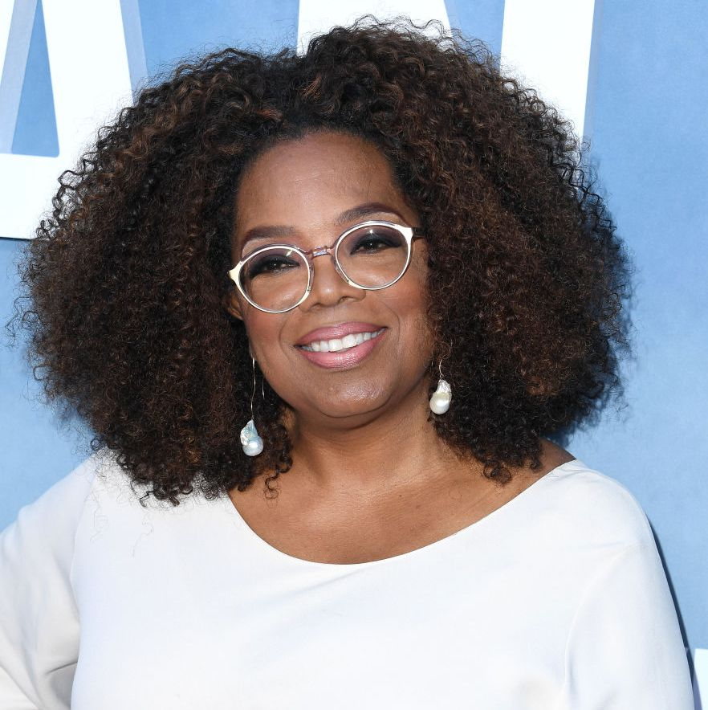
Quote
“I've come to believe that each of us has a personal calling that's as unique as a fingerprint - and that the best way to succeed is to discover what you love and then find a way to offer it to others in the form of service, working hard, and also allowing the energy of the universe to lead you.”
Oprah Winfrey
American talk show host
What does Oprah mean by calling?
Is there something in life you feel called to?
Is having a calling important? ?

Slide 6
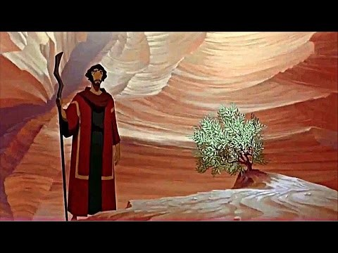
What does the Bible say?
Moses calling to set the Israelites from slavery came from God.
Do you have to believe in a higher power to have a calling?
What else might cause you to feel like you have calling?

Slide 7

What about today?
Moses was born and saved for a specific task – he was called to save the Israelites from slavery. Only Moses could do this task, although God sent Aaron his brother to help him.
This was a specific problem at this time
Discuss:
Can you think of issues that have a big impact on lots of people in our community/country/world?
How do these issues affect people in our community/country/world?
What can people do to help solve these issues?

Slide 8
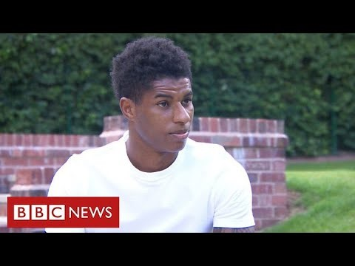
What about today?
Marcus Rashford felt called to make a difference to children who were missing meals.
What motived him?
Is there an issue in life
that you feel needs to
change?
Do you feel called to
make a change?

Slide 9

What now?
In groups discuss what issues you are aware of in your local community, nationally or globally.
Think of ideas of what can be done/what you can do to help solve the issue.
Design a spider diagram or poster to show what you have
discussed.
Notes:
This point is a good time to draw attention to any support, charitable giving and/or courageous advocacy which has emerged from within the school community

Slide 10

I wonder…
I wonder what my community will look like in 6 months’ time if I use my gifts and talents to make a difference
I wonder what my community will look like in a years’ time if I use my gifts and talents to make a difference
I wonder what my community will look like in 10 years’ time if I use my gifts and talents to make a difference
Notes:
This point is a good time to draw attention to any support, charitable giving and/or courageous advocacy which has emerged from within the school community

Slide 11
Prayer
Dear God,
Thank you that you have given us
all unique gifts and talents
and that I was born in this time for a purpose.
Help me to know what you have called me to,
so I can make a difference where you have placed me.
Amen

