Slide 1


Lincoln Diocesan Board of Education Vision
Collective Worship 2023
Secondary
‘Believing we are called into fellowship with God who seeks the flourishing of all, we aspire to strengthen our school communities with wisdom, knowledge and understanding.
Through partnerships firmly rooted in Christian hope and in the love of God, we empower all in our Church school family to love one another with humility, justice and kindness.’
Called Aspirational Rooted Empowering
C A R E

Slide 2
How to use this PowerPoint
These Collective Worship Plans have been created to help school communities understand the LDBE Vision 2023. It shows the theologically underpinning of the story of Moses as well as the other biblical verses linked with the different elements of the vision and C.A.R.E.
The theme of the worship and the biblical background should not be changed, however all the activities and resources can be adapted or changed to suit the needs of your school context, age of the young people and how you deliver your Collective Worship.
Each worship has a mixture of the following sections:
Preparations for the leader of the worship
Quotes to discuss
Biblical teaching
Activity/Information that links to them
What now? - how the theme can impact outside of the worship
Prayer
Under many of the slides there are accompanying notes. Please print the documents with notes pages to use them.
Each worship is not a set amount of time, you can structure it in a way that works for your school and spend as little, or as long, as you see fit. You can also add to it using other resources.
If you have any questions, please contact lynsey.norris@lincoln.anglican.org

Slide 3

Setting the Scene

Slide 4
Before the Worship
Background Information | Moses notices the Burning Bush and responds to it. Noticing is a skill, it is easy to go through the day so focused on what needs doing it’s easy to miss the small things, the things that could change the moment, the things that need our attention. Whether it is a mindful walk, or just taking a breath to have a moment and look around, the Art of Noticing is important
Biblical Teaching | Exodus 3:3 – 12 Moses and The Burning Bush Moses saw that though the bush was on fire it did not burn up.
Background of the Concept and Personal Preparation | Quote: ‘You don’t know, but I’m noticing’ David Levithan Activity: In preparation take an Appreciative Walk: Bringing attention to the beauty of our surroundings is a way to bring deliberate awareness to mindful walking, and to actually shift our perception of the world, out of the “negativity bias” or inherent pessimism wired into us, toward the positive and beautiful. Various experiments have found that focusing on the beauty around us as we walk tends to have a lasting effect on our mood long after we rest, similar to the way other gratitude and appreciation practices work. This research is the inspiration for another mindful walking practice: to simply notice the beauty in the world around us as we walk. It may be a tree beginning to blossom, a particularly beautiful shaft of light, a house or car painted a favourite colour. On your walk, make a regular practice of noticing one positive thing—something beautiful, something funny, or perhaps even an act of kindness—along the way. Read: Background information on Moses https://www.christianity.com/wiki/people/who-was-moses-in-the-bible.html Prayer: Father, I ask today that you help me slow down and take a breath and notice things around me. Let me not miss the little things, or the big things that would otherwise pass by. Let me notice the sunrise and the sunset, the joy and the sadness, the peace and the hub bub. Father, bring to notice the things you want me to see today. Amen

Slide 5
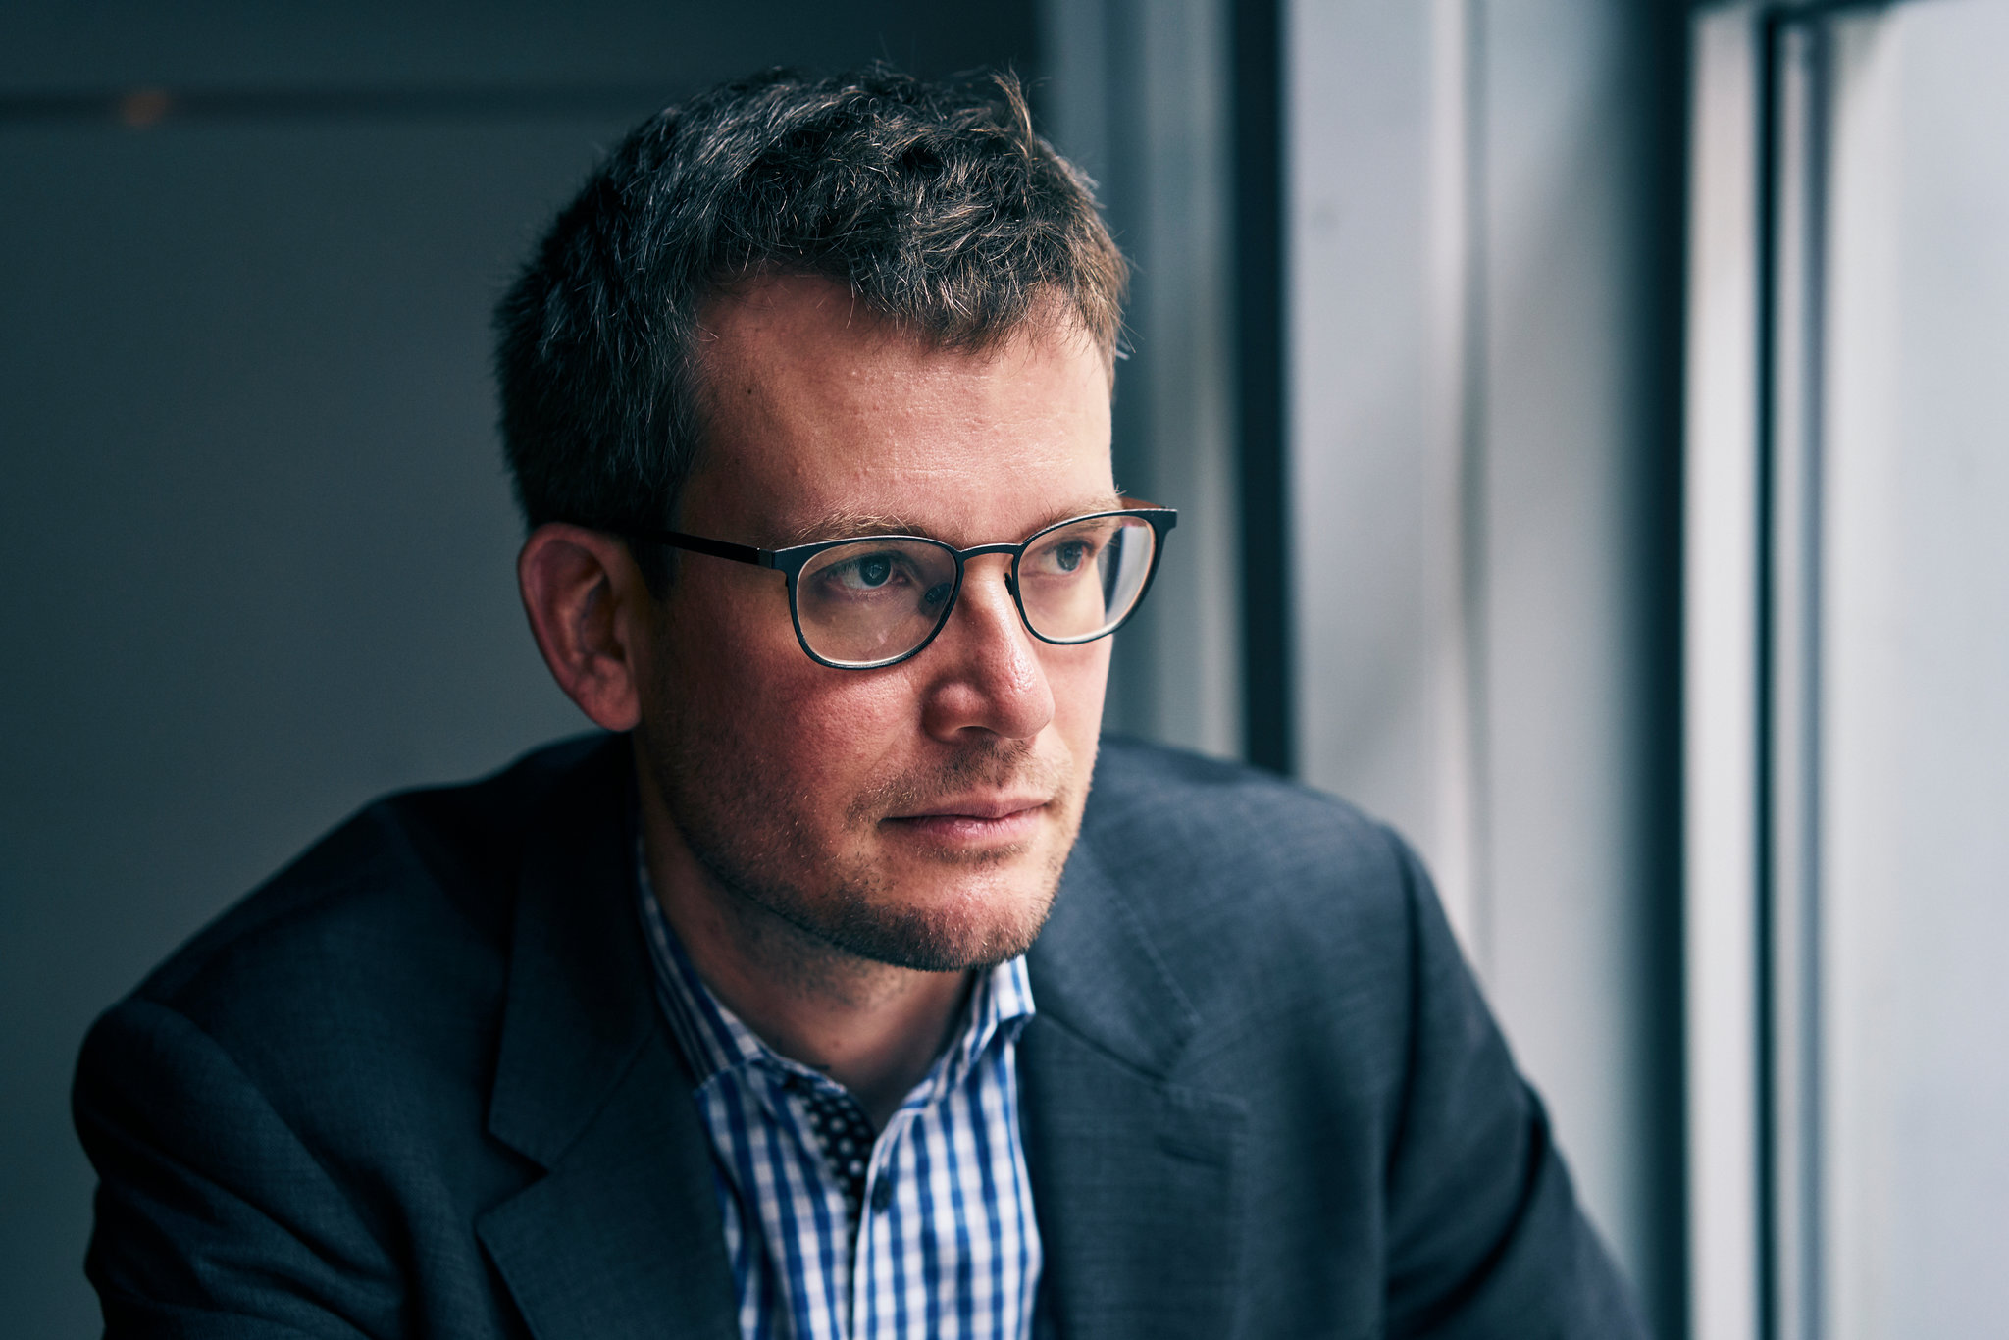
Quote
“The real heroes anyway aren't the people doing things; the real heroes are the people NOTICING things, paying attention.”
John Green (American writer)
Do you agree with John Green?
Why/Why not?
Is noticing important?

Slide 6
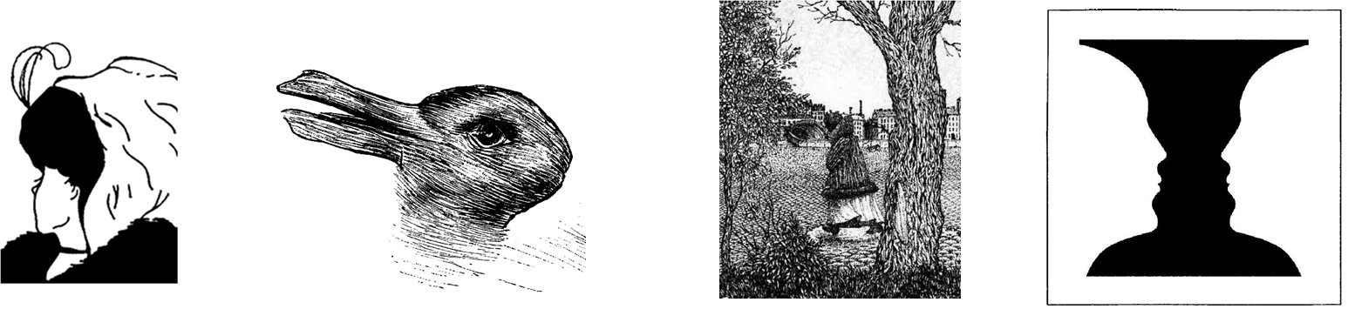
What do you notice?
Notes:
Old or young lady?
Duck or rabbit
Face or girl walking?
Vase or two faces?

Slide 7
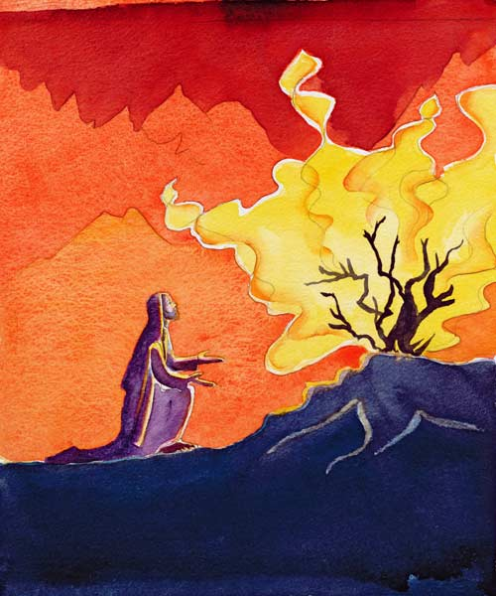
What does the Bible say?
Moses and the Burning Bush - Exodus 3:3-12
Now Moses was tending the flock of Jethro his father-in-law, the priest of Midian, and he led the flock to the far side of the wilderness and came to Horeb, the mountain of God. 2 There the angel of the LORD appeared to him in flames of fire from within a bush. Moses saw that though the bush was on fire it did not burn up. 3 So Moses thought, “I will go over and see this strange sight—why the bush does not burn up.”
4 When the LORD saw that he had gone over to look, God called to him from within the bush, “Moses! Moses!”
And Moses said, “Here I am.”
5 “Do not come any closer,” God said. “Take off your sandals, for the place where you are standing is holy ground.” 6 Then he said, “I am the God of your father, the God of Abraham, the God of Isaac and the God of Jacob.” At this, Moses hid his face, because he was afraid to look at God.
7 The LORD said, “I have indeed seen the misery of my people in Egypt. I have heard them crying out because of their slave drivers, and I am concerned about their suffering. 8 So I have come down to rescue them from the hand of the Egyptians and to bring them up out of that land into a good and spacious land, a land flowing with milk and honey—the home of the Canaanites, Hittites, Amorites, Perizzites, Hivites and Jebusites. 9 And now the cry of the Israelites has reached me, and I have seen the way the Egyptians are oppressing them. 10 So now, go. I am sending you to Pharaoh to bring my people the Israelites out of Egypt.”
11 But Moses said to God, “Who am I that I should go to Pharaoh and bring the Israelites out of Egypt?”
12 And God said, “I will be with you. And this will be the sign to you that it is I who have sent you: When you have brought the people out of Egypt, you will worship God on this mountain.”
Notes:
Discuss: Moses noticed the burning bush, it was something unusual and out of the ordinary, however it results in him being given a task to free the Israelites from Egyptian slavery.
Noticing is important and can change situations.
Point to linger on:
What situations have changed because someone notice something?
Discuss things in history that change because someone was observant and took note

Slide 8
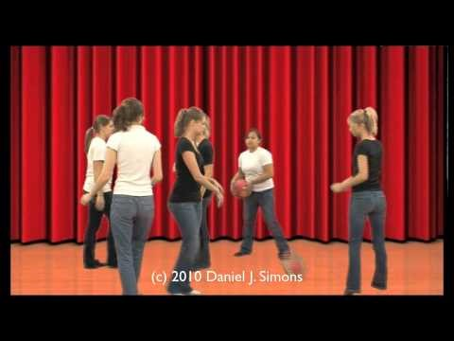

Do you notice things in life?
Notes:
Discuss:
Are you observant?
Do you notice things?
Do you always have your headphones in and look at your phone?
What might you have missed?

Slide 9

What now?
Taking notice is good for our mental health
‘Take Notice’ is about paying attention (on purpose) to what is going on around you and how you feel, in the present moment.
It is sometimes hard to see how just ‘Taking Notice’ can help us feel happier and healthier. However, taking time to focus on the here and now within this busy, confusing and sometimes scary world we live in can help us:
Enjoy life and appreciate what we have
Understand ourselves better
Stay calm
Think about how to approach challenges
‘Take Notice’ is connected to mindfulness – a popular meditation practice that encourages people to notice and accept their current thoughts and feelings, whilst staying in the present moment (which means trying not to focus on the past or future)
Notes:
This information can be found at https://www.manchestermind.org/take-notice/

Slide 10
What now? Ways to take notice
A good place to start is with our five senses: smell, sight, hearing, touch and taste. Suggested activity: Take a seat somewhere comfortable. Then, spend a few minutes noticing: Five things you can see Four things you can touch Three things you can hear Two things you can smell One thing you can taste This exercise is great for calming your mind if you are feeling distracted. | Do Something Different People tend to like routine and things that are familiar. However, shaking things up and doing something differently, than how we normally would, encourages us to take notice and appreciate our surroundings. Suggested activity: What small, five-minute change could you make to today? Here are some suggestions if you are stuck for ideas: De-clutter your desk or bedroom floor Have something different for breakfast Listen to a piece of music you would not normally pick Look out your window and find three things you have never noticed before
Music We often have music on in the background, like the radio or a playlist, but do not really notice it. Giving your full attention to music you really enjoy, is a nice way to take notice. Suggested activity: Put on some music that usually makes you feel happy. Spend some time listening to it without doing any other activity. Notice what happens in your body as you listen – Are you smiling? Does your body feel relaxed? Or do you feel like moving to the music? (If you do, go for it!) After listening for a while, consider these questions: Did it feel different to just focus on the music and nothing else? Did the music bring back any memories? How do you feel now, afterwards?
Notes:
This activities can be found at https://www.manchestermind.org/take-notice/

Slide 11
Prayer
God,
I ask today you help me slow down and take a
breath and notice things around me.
Let me not miss the little things,
or the big things that would otherwise pass by.
Let me notice the sunrise and the sunset,
the joy and the sadness,
the peace and the hub bub.
God, bring to notice the things you want me to see today.
Amen.

