Slide 1


A Life of Service:
Jonathan and the Armour-Bearer
Collective Worship
Spring Term 2021

Slide 2
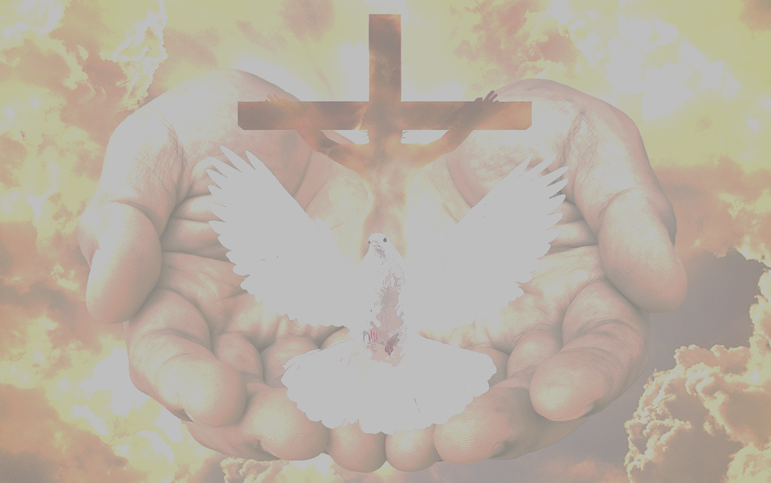
We gather together in the name of…
Welcome
  The Holy Trinity, three in one, joined together in the Divine Dance and showing that all are made in God’s image- to love, serve and make room for each other.

Slide 3

The Divine Dance: A God of Relationships

Slide 4
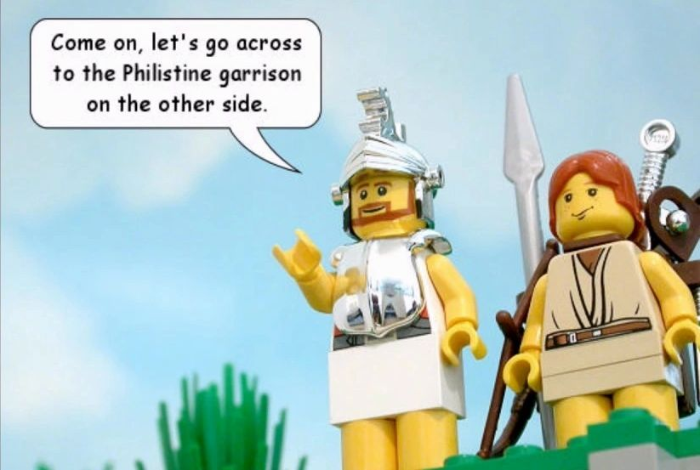
Jonathan and His Armour-Bearer
Learning

Slide 5
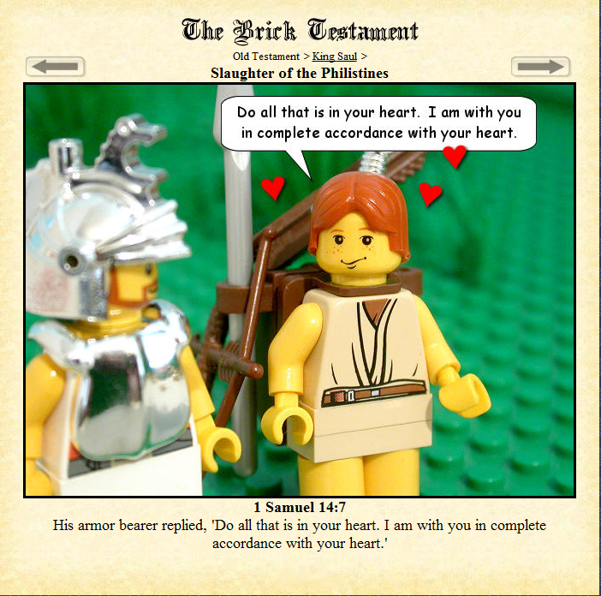
And his armour-bearer said to him, ‘Do all that is in your heart. I am with you in complete accordance with your heart’. 1 Samuel 14:7
Reflecting

Slide 6

‘In accordance with your heart’: Serving Through Supporting
Responding

