Slide 1


A Life of Service:
Man lowered Through the Roof
Collective Worship
Spring Term 2021

Slide 2
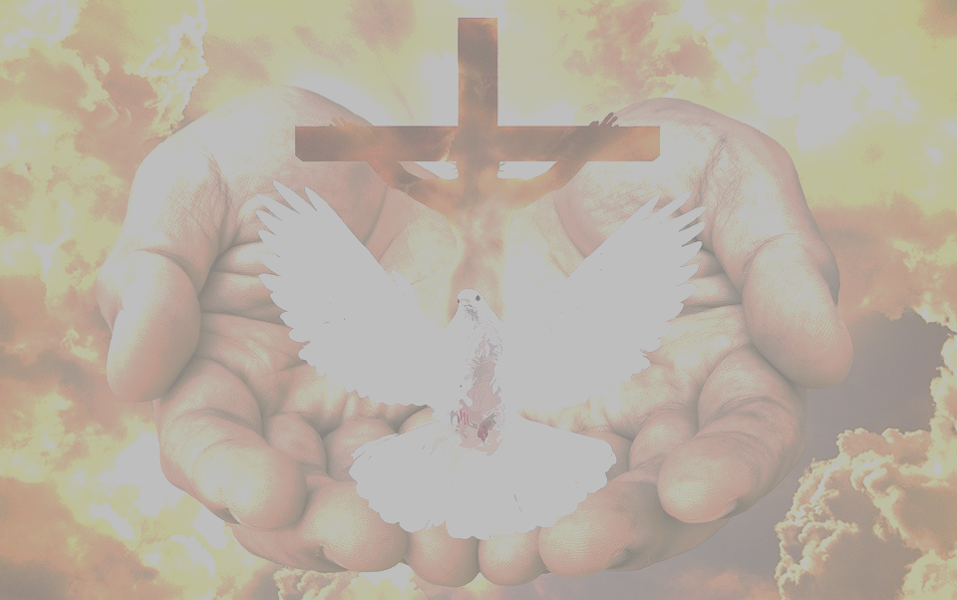
We gather together in the name of…
Welcome
  God the Father, who sees the struggles of humanity
  Jesus the Son, who shows love for others through the things that he does
  The Holy Spirit, who made amazing things happen in the Bible!

Slide 3
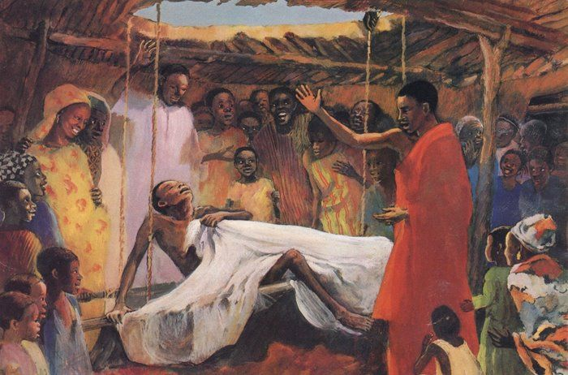
Lowered to blessing
Learning

Slide 4
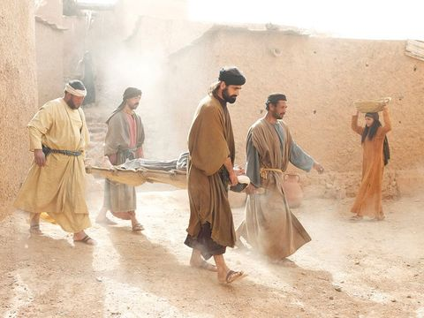

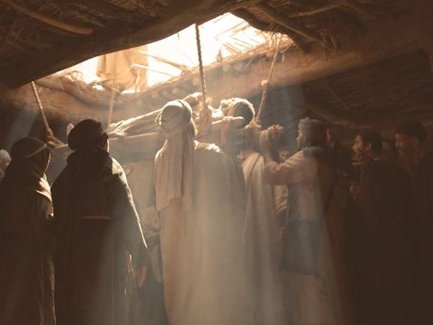
Stronger Together: Team Work!
Reflecting

Slide 5
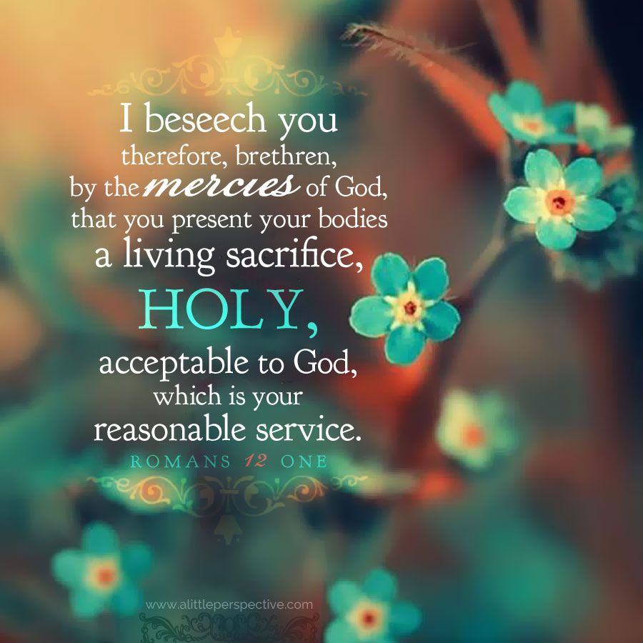
Using Your Body for Service to God
Reflecting

Slide 6
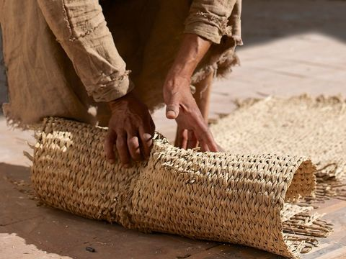
Takeaway Blessings: pay It Forward
Responding
“I tell you, get up, take your mat and go home.” ¹² He got up, took his mat and walked out in full view of them all. This amazed everyone and they praised God, saying, “We have never seen anything like this!”
Mark 2: 11-12

Slide 7
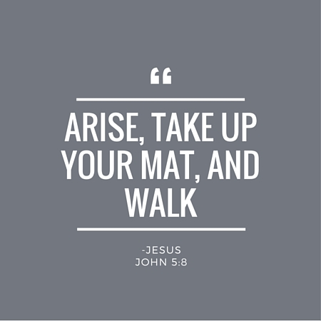
Responding
M- Me, I can change the world with my kindness and good deeds
A- All it takes is me and my friends helping those who need our strength
T- That can start today and who knows what we can achieve tomorrow?

