Slide 1


A Life of Service:
Queen Esther
Collective Worship
Spring Term 2021

Slide 2

We gather together in the name of…
Welcome
  God the Father, who protected His people, the Jews through one young woman
  Jesus the Son, who was called to do a task for His Father
  The Holy Spirit, who gives Christians courage when they need it

Slide 3
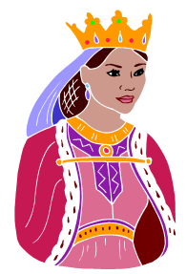
Queen Esther
Learning

Slide 4

For Such a Time As This
Reflecting

Slide 5














Who Needs Your Voice?
Responding

