Slide 1

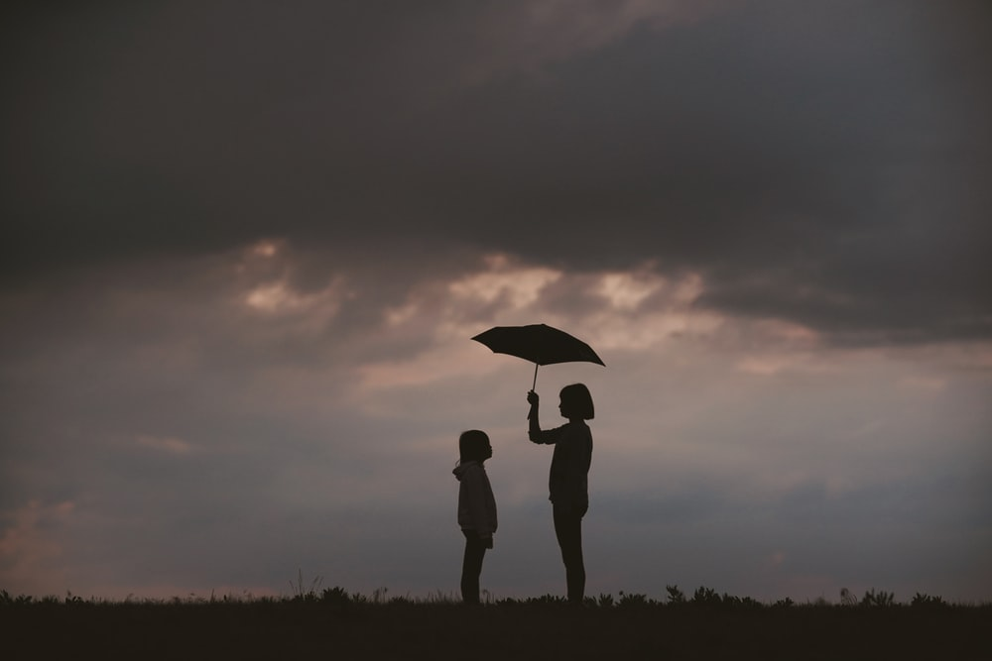
A Life of Service:
Resurrection of Dorcas
Collective Worship
Spring Term 2021

Slide 2
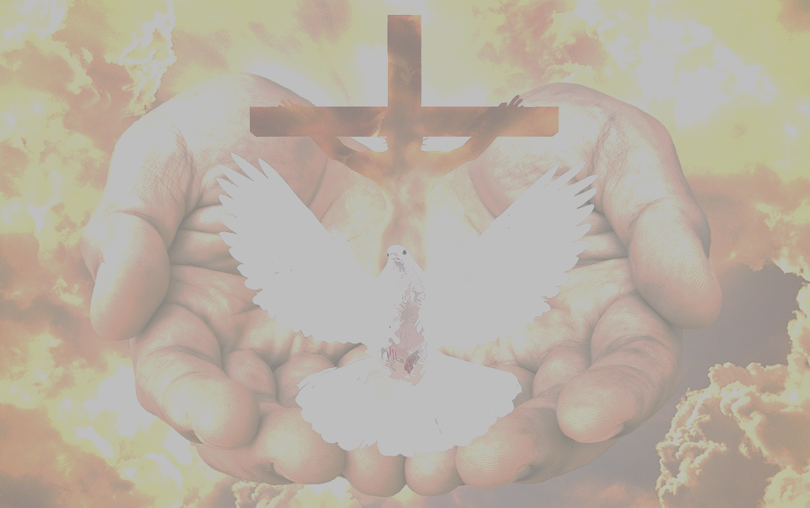
We gather together in the name of…
Welcome
  God the Father, who loves all
  Jesus the Son, who showed Christians how to live a life of service
  The Holy Spirit, who shows believers those who most need help

Slide 3
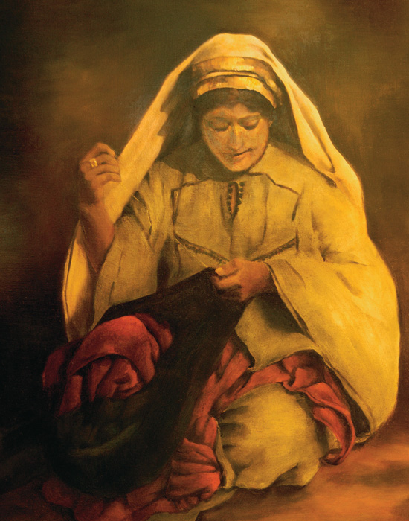
Dorcas: Kindness Through Serving
Learning

Slide 4
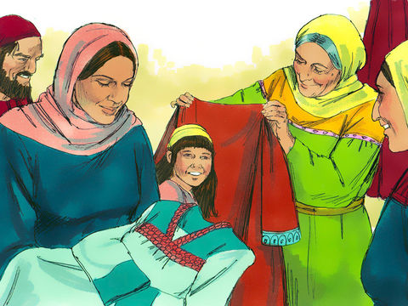
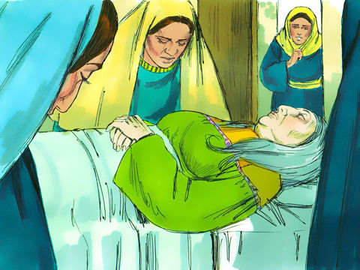
The Resurrection of Dorcas
Learning

Slide 5
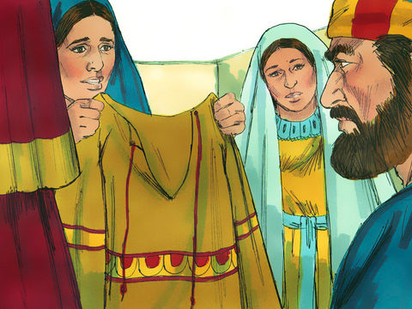
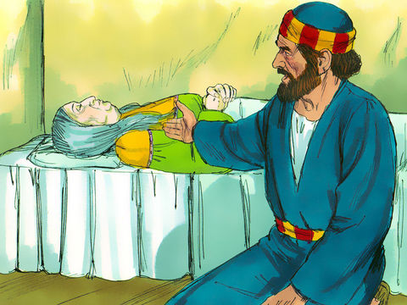
The Resurrection of Dorcas
Learning

Slide 6
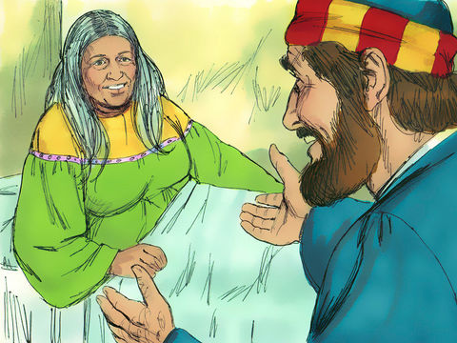
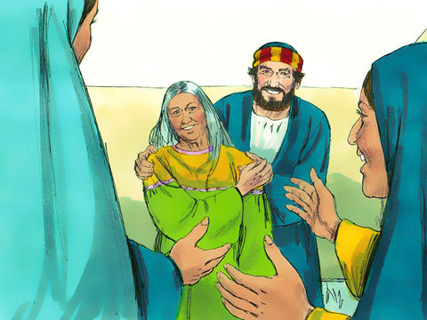
The Resurrection of Dorcas
Learning

Slide 7

“The people should not think that small beginnings are unimportant”
Zechariah 4:10
Learning

Slide 8
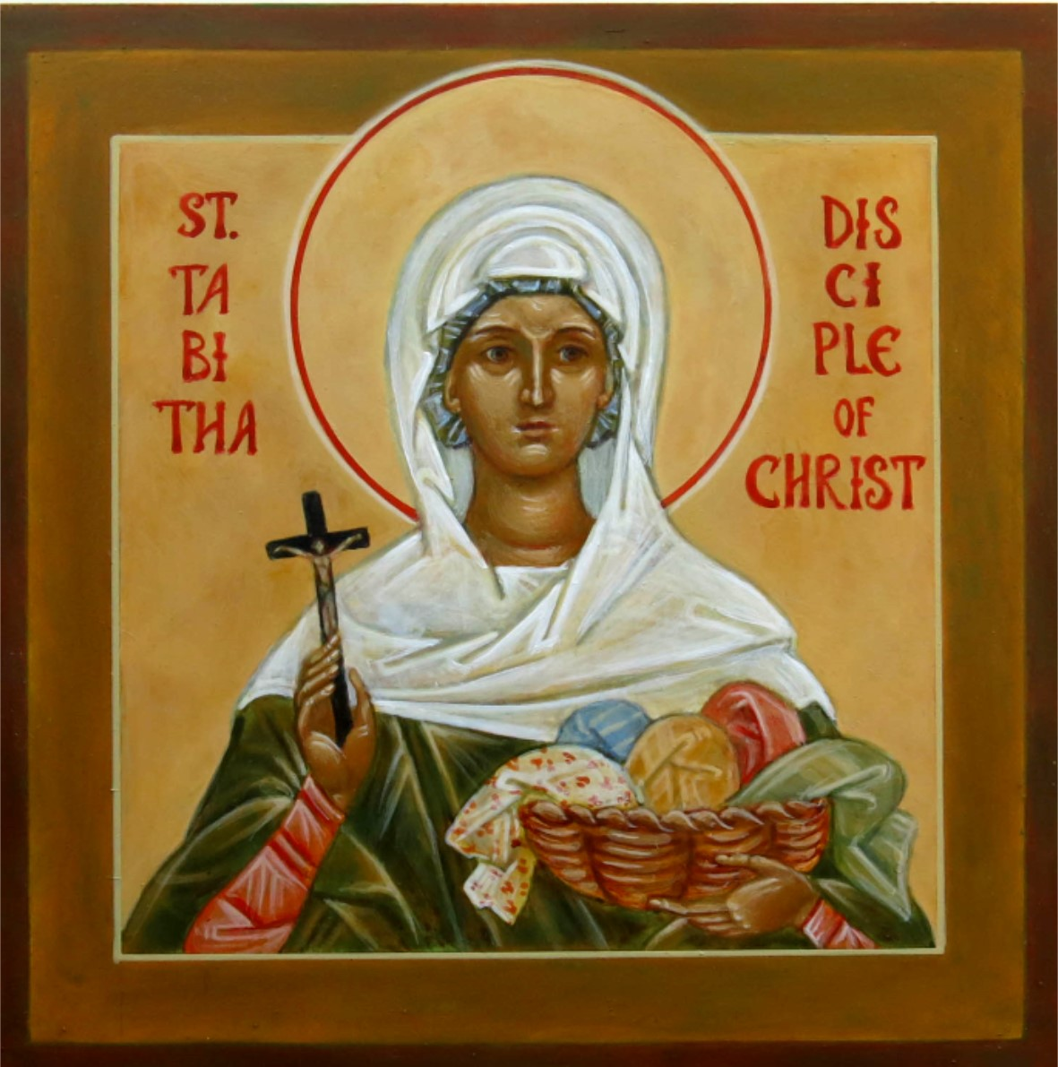

You’ve GOT Talent!
Reflecting

Slide 9

Hands That Serve
Responding
‘Then the King will answer, ‘I tell you the truth. Anything you did for any of my people here, you also did for me.’ Matthew 25:40

