Slide 1
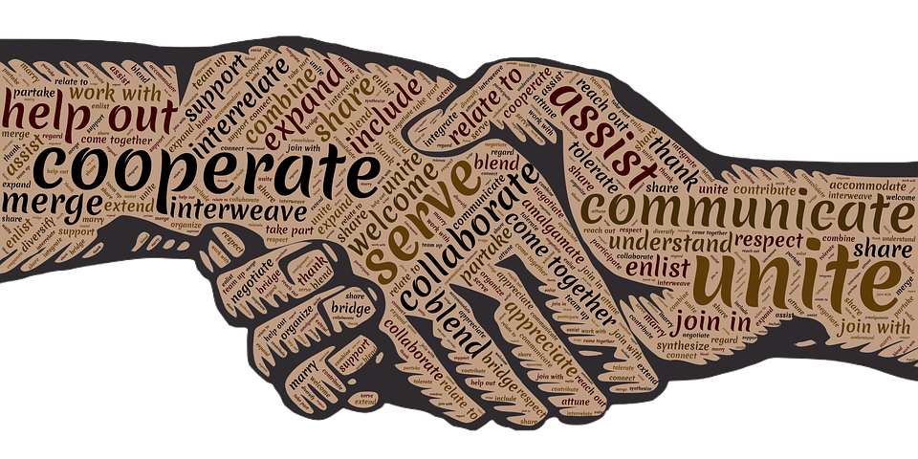

A Life of Service:
Ruth and Naomi
Collective Worship
Spring Term 2021

Slide 2
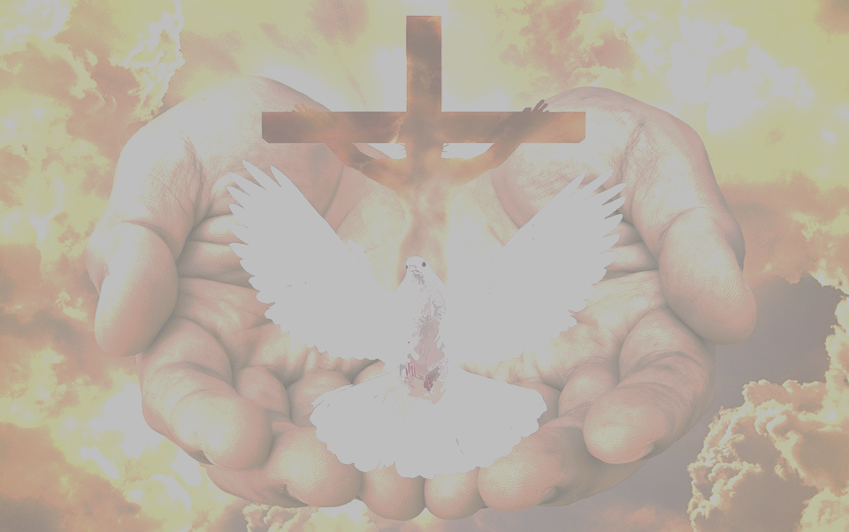
We gather together in the name of…
Welcome
  God the Father of all, near and far
  Jesus the Son, who descended from Ruth in our story today
  The Holy Spirit, who prompts believers to serve those in need, like Naomi

Slide 3
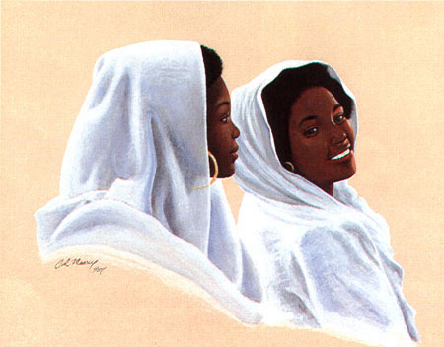
The Story of Ruth and Naomi
Learning
Ruth answered, "Please don't tell me to leave you and return home! I will go where you go, I will live where you live; your people will be my people, your God will be my God.
Ruth 1:16

Slide 4
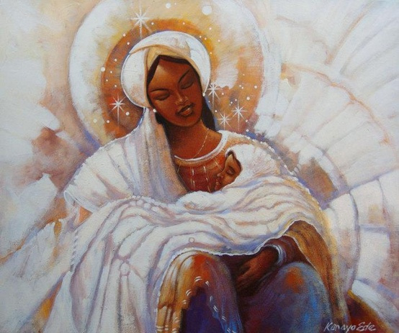
The Story of Ruth and Naomi
Learning
¹⁷ Whoever is kind to the poor lends to the Lord, and he will reward them for what they have done.
Proverbs 19:17
¹⁰ God is not unjust; he will not forget your work and the love you have shown him as you have helped his people and continue to help them.
Hebrews 6:10
Ruth gave birth to a son and she became the ancestor of Jesus himself! God did not forget her service!

Slide 5
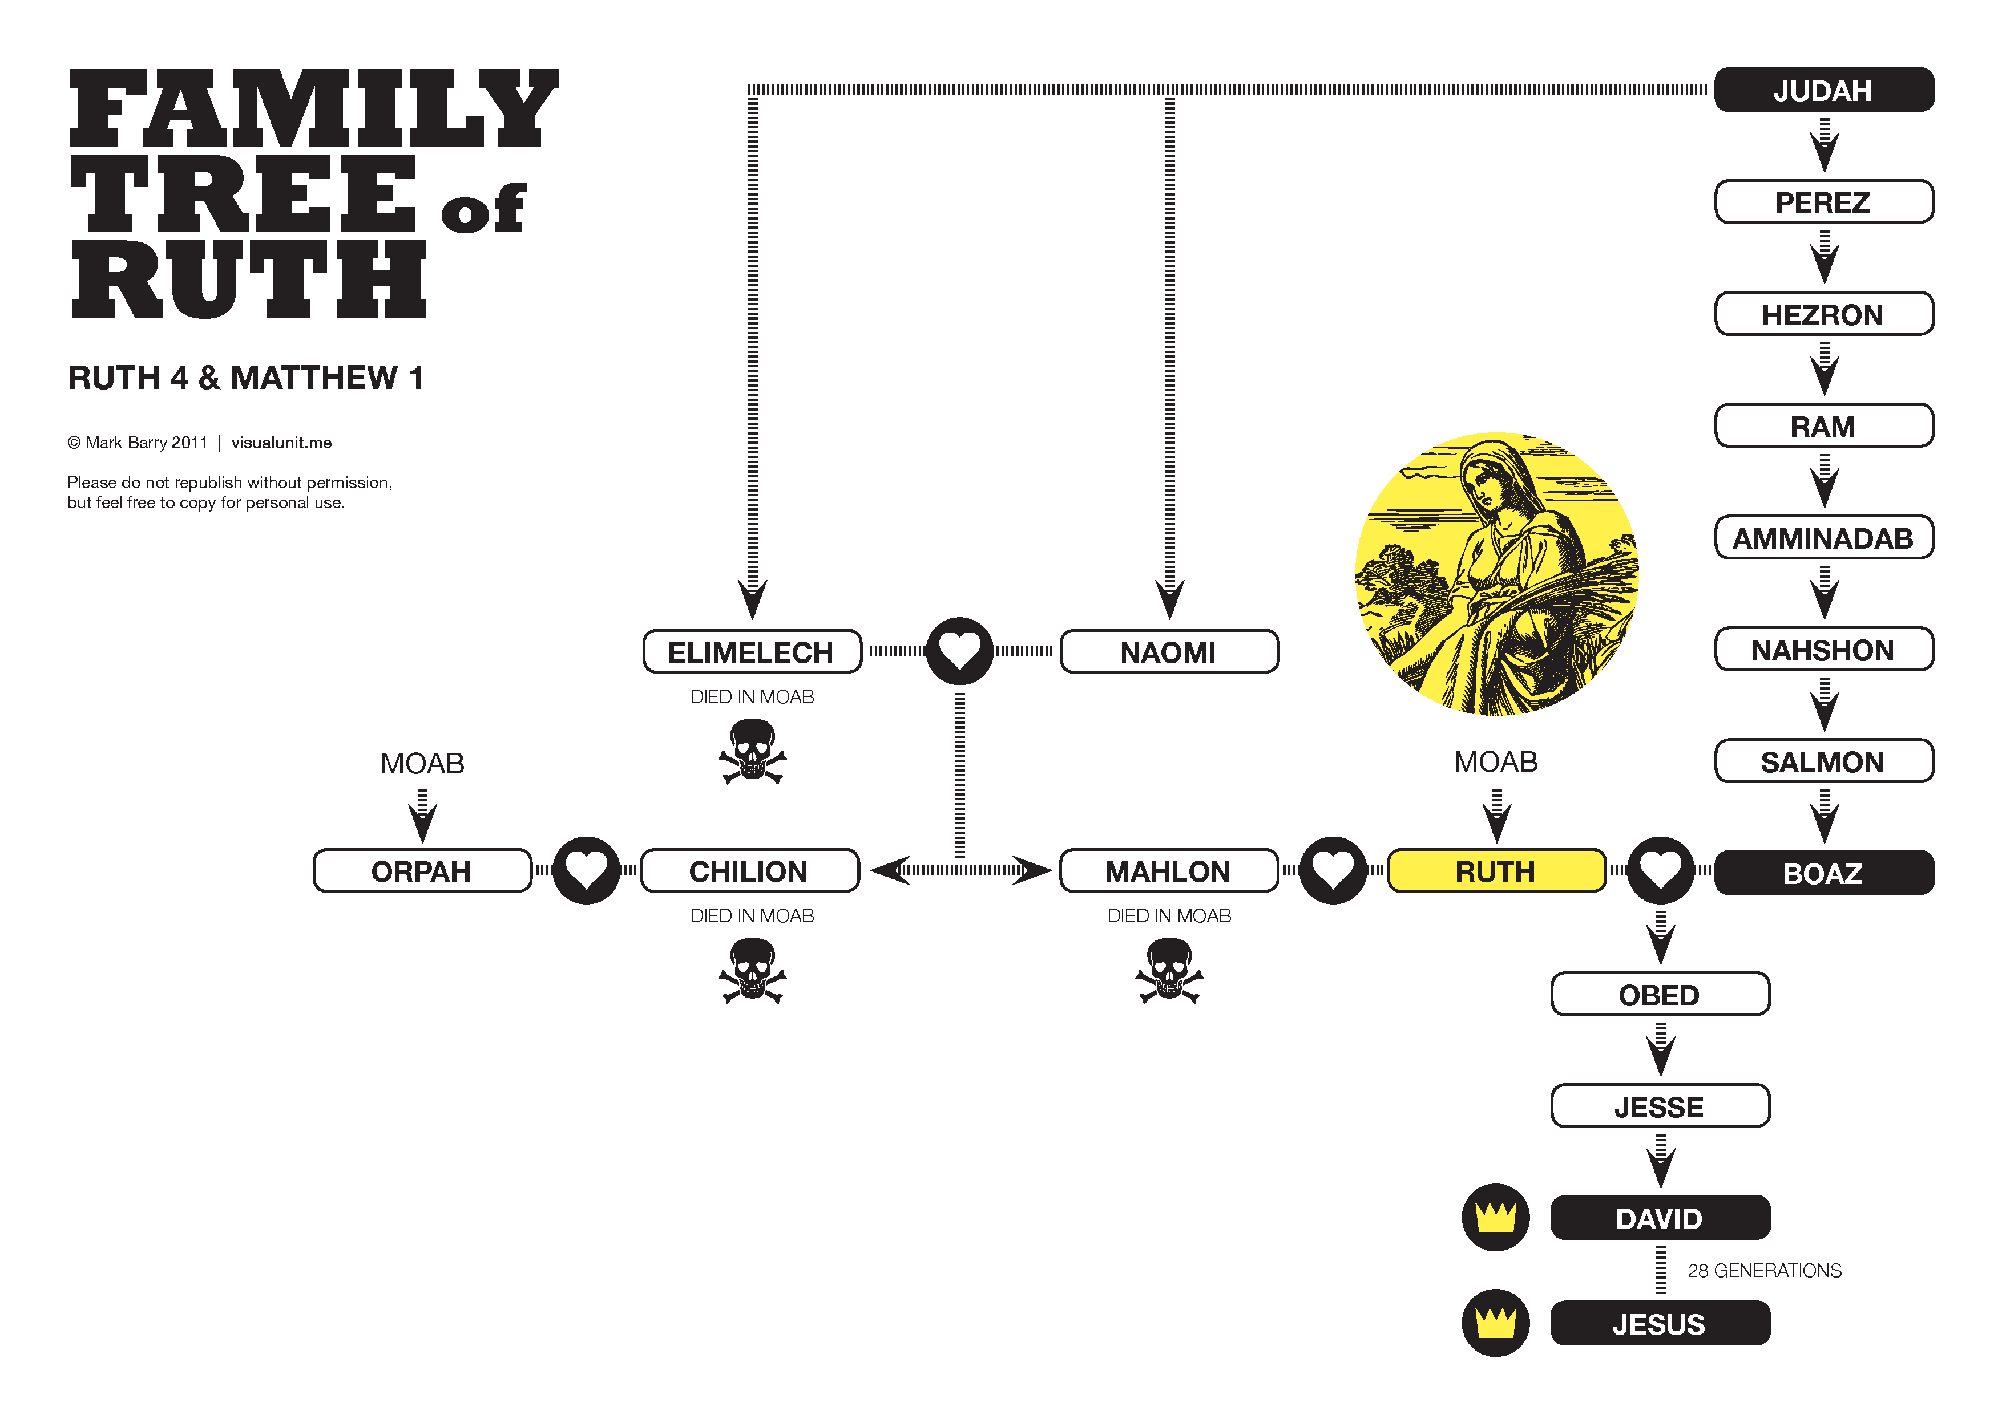

Slide 6

Serving Others Feels Good!
Reflecting
A generous person will prosper;
whoever refreshes others will be refreshed.
Proverbs 11:25

Slide 7

Who Can You Walk With?
Responding

