Slide 1

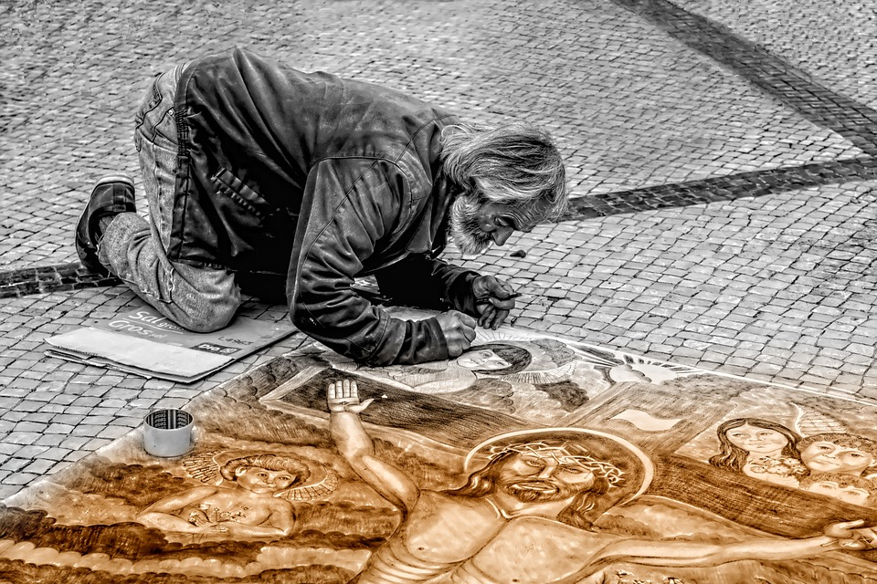
A Life of Service:
Jesus
Collective Worship
Spring Term 2021

Slide 2

We gather together in the name of…
Welcome
  God the Father, who Christians believe sent His son
  Jesus the Son, who is known as the Servant King
  The Holy Spirit, who inspires Christians to do good deeds

Slide 3
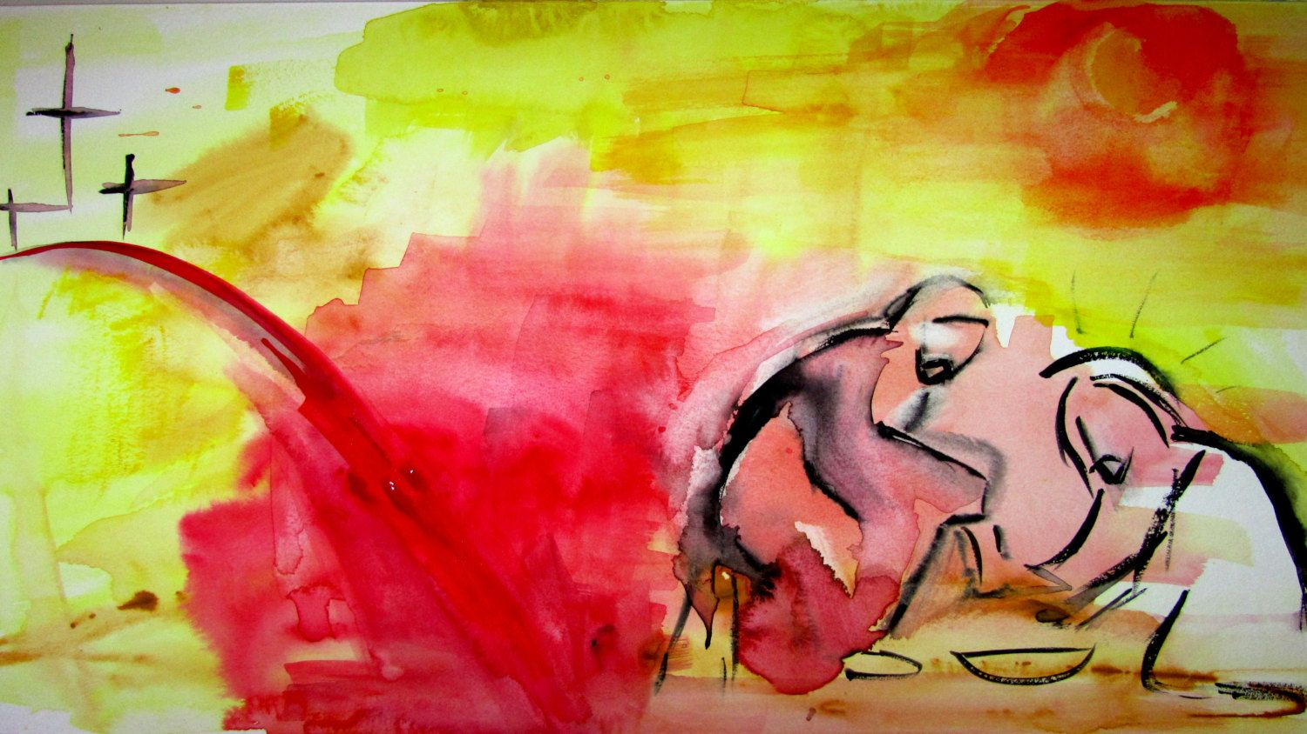
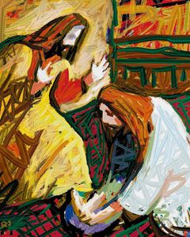
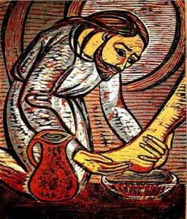
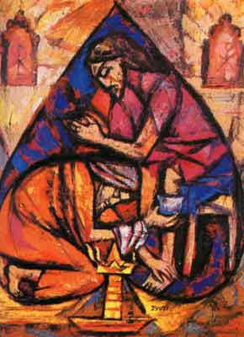
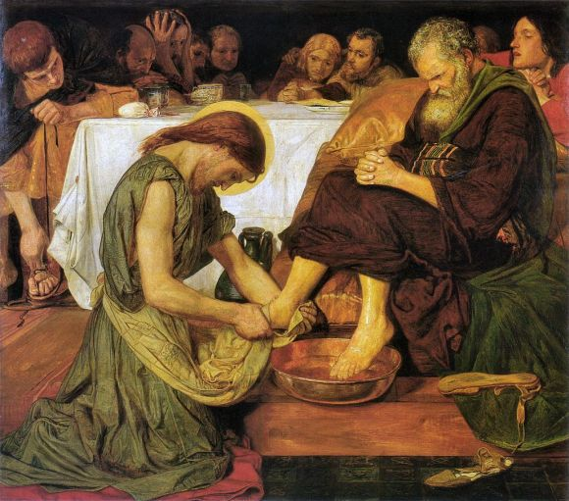
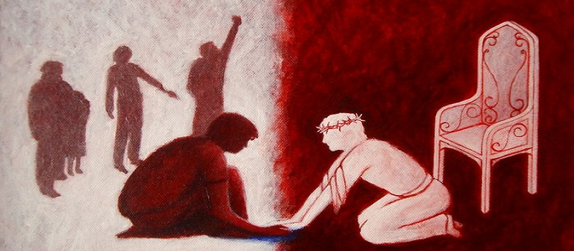
Learning
Incarnation: God with us

Slide 4
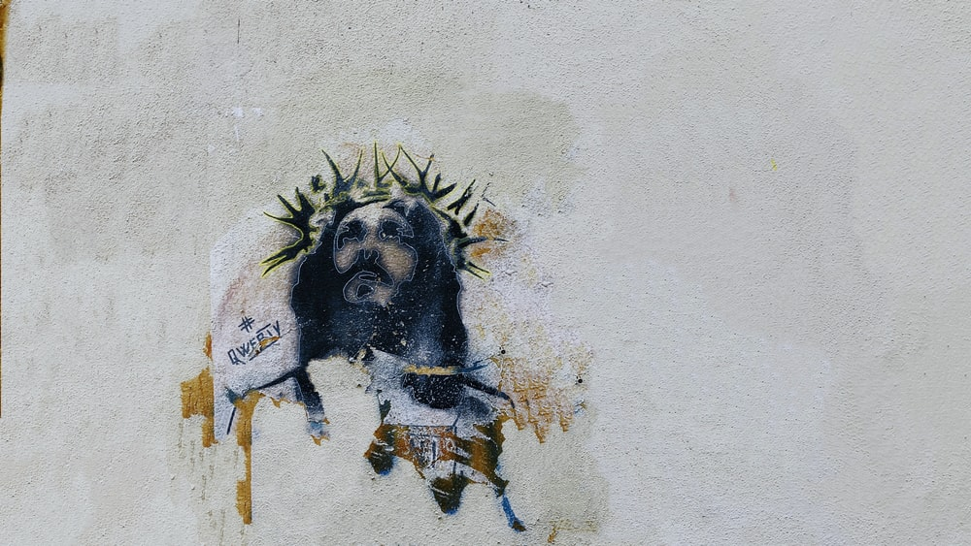
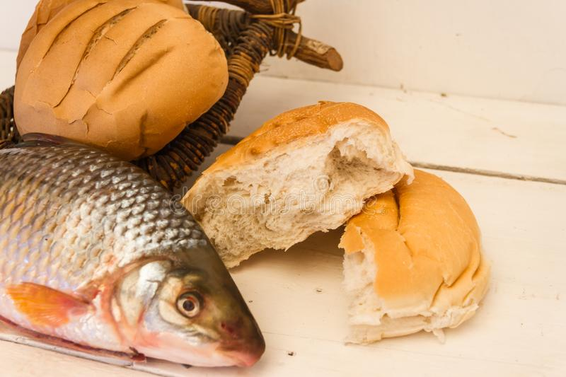
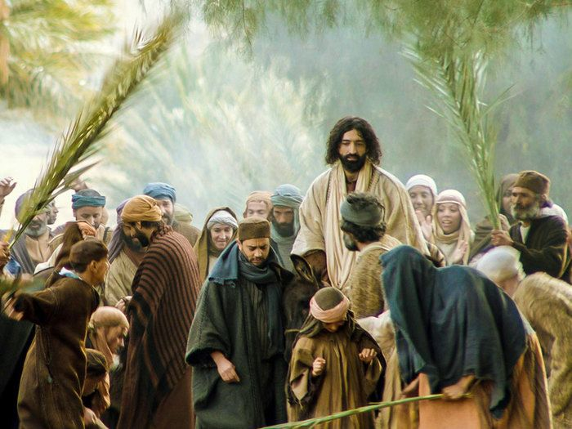

Jesus: The Servant King
Learning
Jesus was a servant king. He fed the crowds, entered Jerusalem on a humble donkey and washed the feet of his disciples.
Even though he was the Son of God he was humble, helping and serving others to show the love of God.

Slide 5

Learning
‘He that is the greatest among you shall be your servant.’ Matthew 23:11
’For even the Son of Man did not come to be served, but to serve, and to give his life as a ransom for many.’ Mark 10:45

Slide 6
Service as the Christian Way of Living
Learning
Service is at the heart of the Christian’s relationship with God and with others.
Counsel
Help
Love
One another…
Encourage
Care for
Support
Pray for

Slide 7
It’s not easy!
Reflecting
Serving others is hard.
It is making a choice to put someone else first and use your skills to help someone who needs it.
For Christians, it is rewarded with treasure in heaven, not on Earth:
¹⁹ “Do not store up for yourselves treasures on earth, where moths and vermin destroy, and where thieves break in and steal. ²⁰ But store up for yourselves treasures in heaven, where moths and vermin do not destroy, and where thieves do not break in and steal. ²¹ For where your treasure is, there your heart will be also.
Matthew 6: 19-21
⁷ But as for you, be strong and do not give up, for your work will be rewarded.”
2 Chronicles 15:7

Slide 8


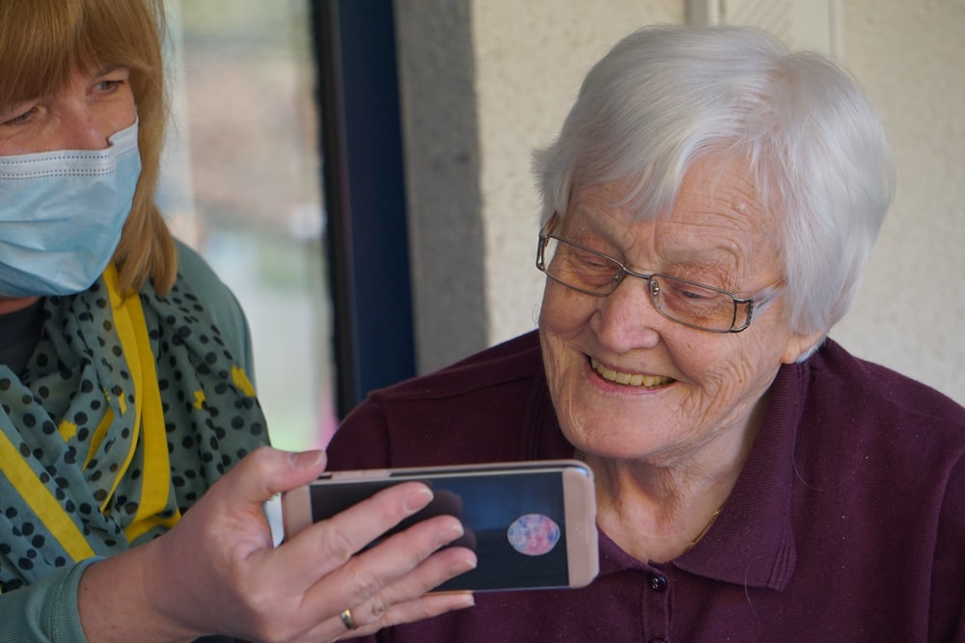


Covid-19 Heroes
Reflecting

Slide 9
Courageous Advocacy
Reflecting
Having courage, being brave and bold. Not put off by obstacles.
Supporting, being a voice for, standing alongside
When Jesus saw the poor, the excluded, the sick, the hurt and the vulnerable, he did something to help them.
You can do that too!

Slide 10

Secret Service
Responding
What Would Jesus Do?
What can you do to serve others?
If you want to do it as Jesus said, do it in secret, so only the Father in heaven sees.

