Slide 1
A life well-lived
All photos © www.royal.uk, unless otherwise listed
Notes:
Slide 1: ‘A life well-lived’ – what do we mean by this? Who would say that it’s important to try to do this, to live your life well? We often talk about this during our assemblies, thinking about ways to create a better, more loving school community. ‘A life well-lived’ is also about making the most of every moment, every opportunity that’s before us, living not just for ourselves, but for others.

Slide 2
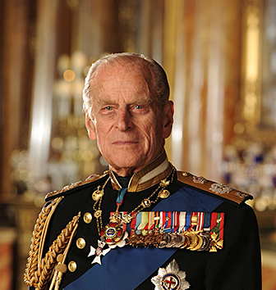
HRH Prince Philip, Duke of Edinburgh
1921 - 2021
Notes:
Slide 2: Today we gather together to mourn the loss of an important member of our Royal family – the Queen’s husband, Prince Phillip, the Duke of Edinburgh, who has died. We are going to use some photos from this remarkable man’s life, to help us as we remember. He was often by the Queen’s side, and it’s hard for us to imagine how she and her family must be feeling at this time.

Slide 3
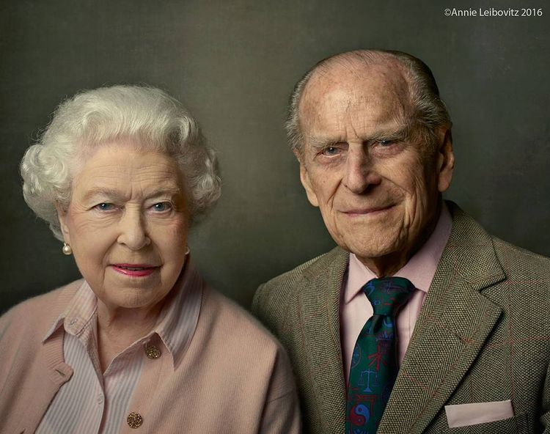
“My strength and stay”
Notes:
Slide 3: The Queen referred to him as her ‘strength and stay’. As you’ll see and hear, the Duke of Edinburgh lived a long life, working beside the Queen until he was well into his nineties, and he did much good for the benefit of others….

Slide 4
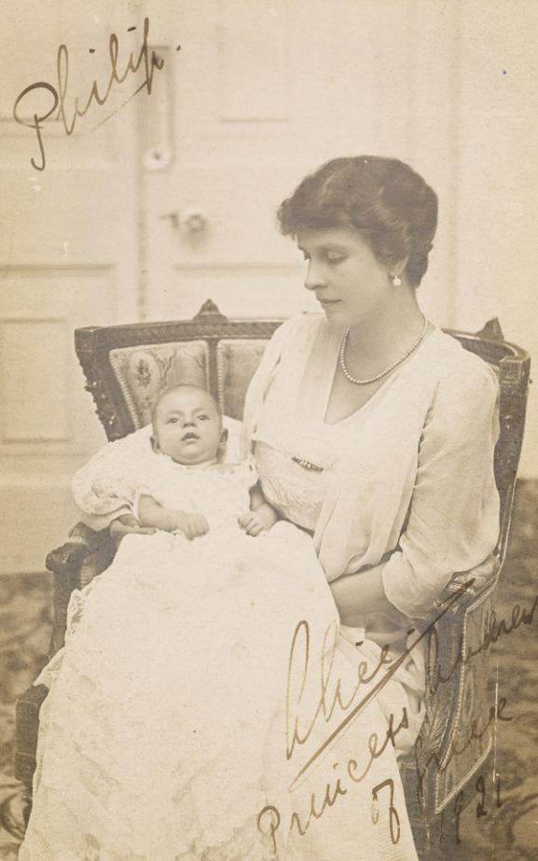
Philip, Prince of Greece and Denmark
10th June 1921
© www.royal.uk
Notes:
Slide 4: The Duke of Edinburgh was royal even before he married the Queen: he was born the only son of Prince Andrew of Greece, and Princess Alice of Battenberg (in Denmark), so held the title ‘Prince of Greece and Denmark’.

Slide 5
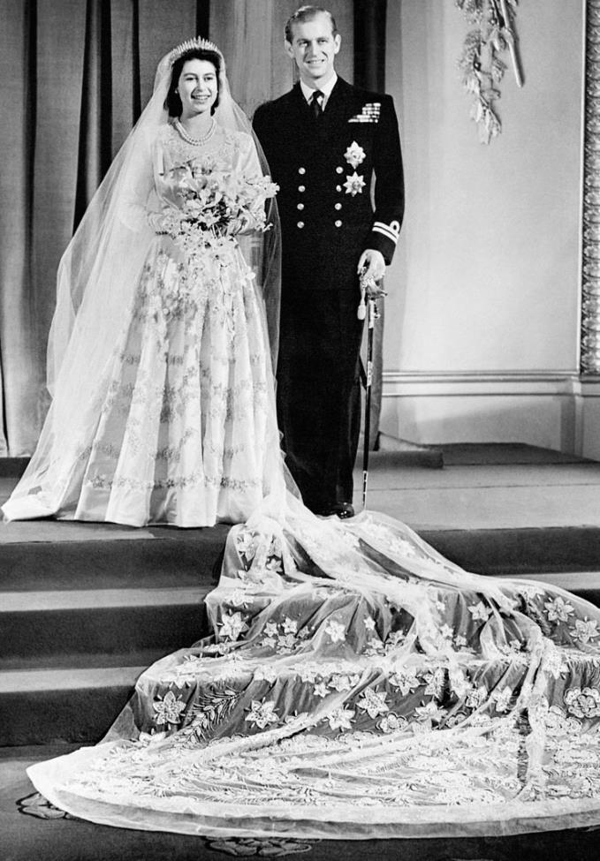
Wedding of HM Queen and Prince Philip
November 20th 1947
© www.royal.uk
Notes:
Slide 5: He gave up his own royal title to marry the Queen in 1947.

Slide 6
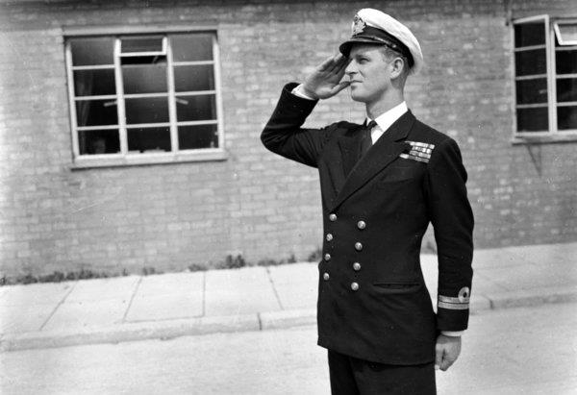
A career in the Royal Navy
© www.royal.uk
Notes:
Slide 6: He also gave up his job in the Royal Navy to be by her side.

Slide 7
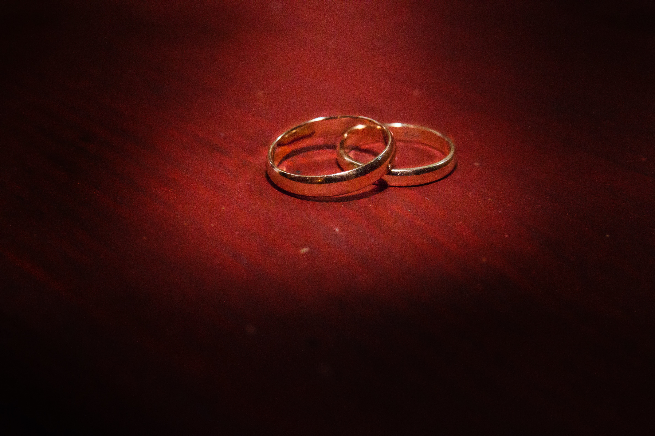
Platinum Wedding Anniversary
20th November 2017
Tetiana SHYSHKINA on unsplash
Notes:
Slide 7: They had a long marriage and celebrated their Platinum wedding anniversary (70 years) in 2017.

Slide 8
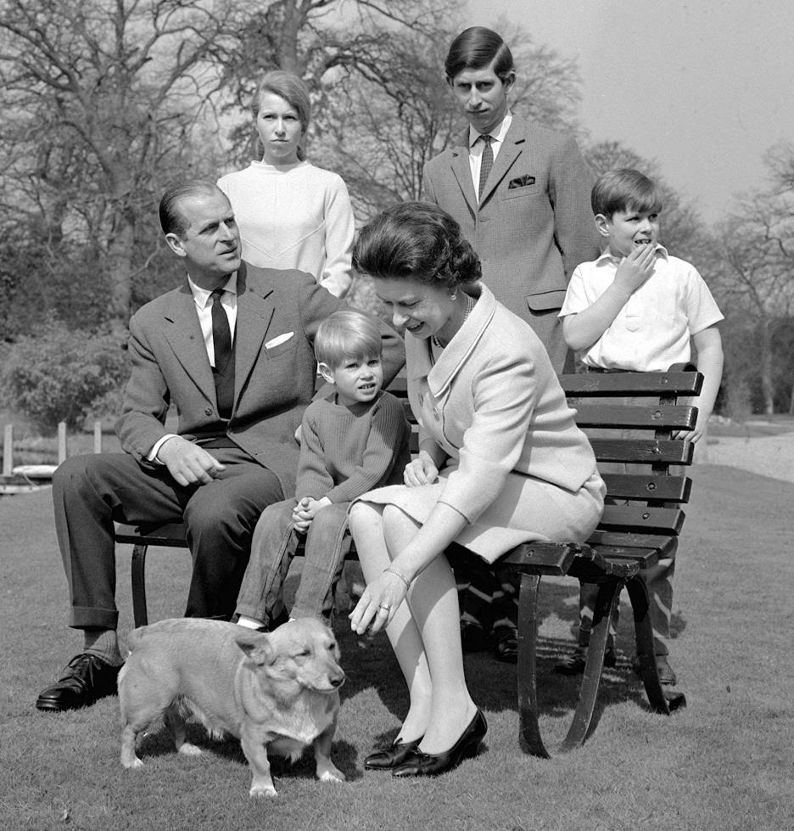
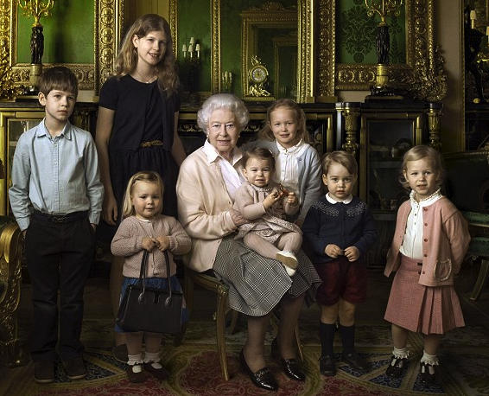
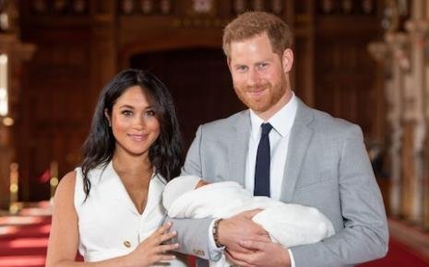
A family man
1968
2016
Louise
James
Savannah
Isla
Charlotte
George
Archie, 2019
Mia
© www.royal.uk
Notes:
Slide 8: With the Queen, he had four children, eight grandchildren and five great-grandchildren.

Slide 9
Duke of Edinburgh awards for 14-24 year olds
1956-present day
Notes:
Slide 9: He was best-known for setting up the Duke of Edinburgh awards scheme which will be his legacy for many years to come. He set the scheme up in 1956, so it’s been going for over 60 years. This inspirational scheme has shaped millions of young peoples’ lives over the years, encouraging them to challenge themselves physically and change their local community by volunteering. In September 2016, the Countess of Wessex, the Duke’s daughter-in-law, took part in a 445 cycle ride from Edinburgh to London to celebrate DofE awards’ 60th anniversary.

Slide 10
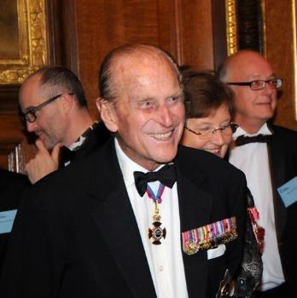
Patron and ambassador
© www.raeng.org.uk
Pixabay.com
Notes:
Slide 11: He was an ambassador for the science and technology industries and sporting organisations and a patron or president of 785 different organisations, including Lord’s Cricket Ground and Wimbledon (All England Lawn and Tennis Club). In the 1970’s he set up the Royal Academy of Engineering which changed the face of the engineering profession and created opportunities for new types of engineering as technology changed.

Slide 11
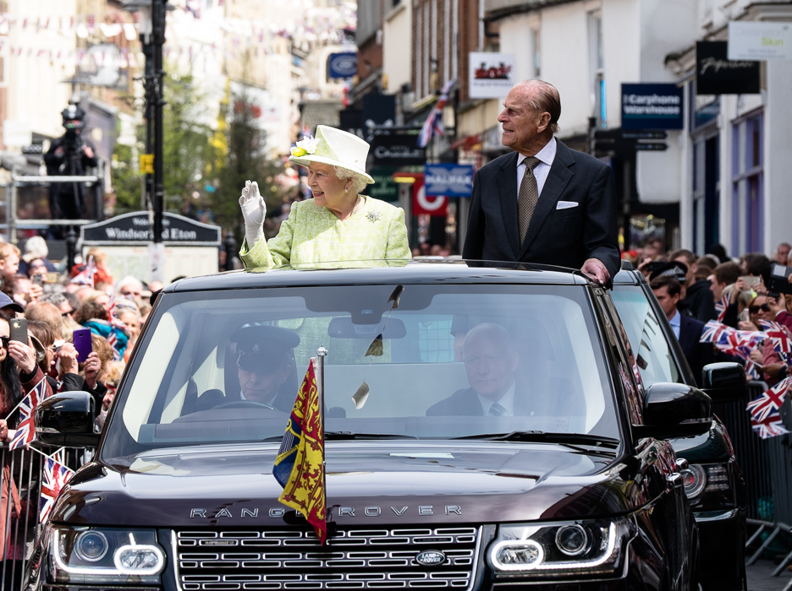
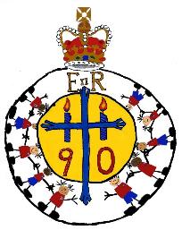
Celebrating with the Queen
© www.royal.co.uk
Notes:
Slide 12: In 2009, he became the longest-serving consort (companion) to a reigning monarch, and was at her side as she celebrated her Diamond Jubilee in June 2012 and her 90th birthday in June 2016.

Slide 12
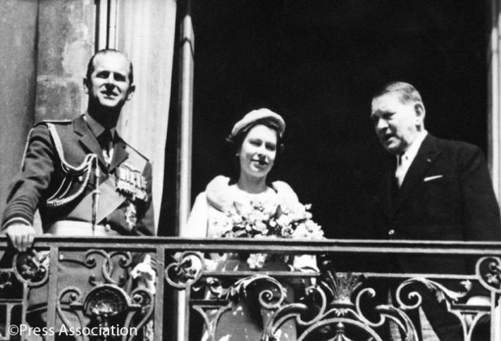
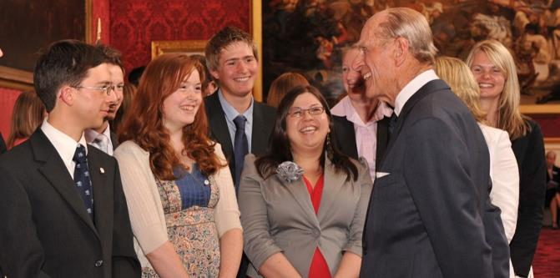
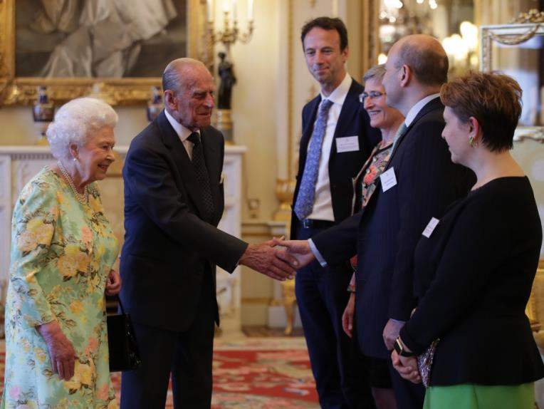
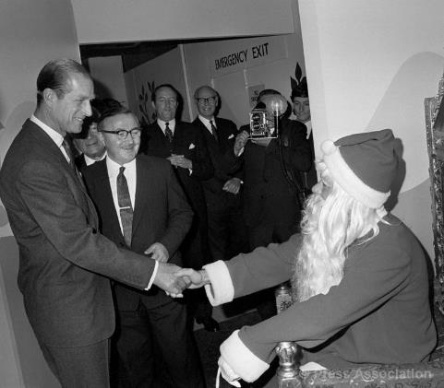
Royal engagements
© www.royal.co.uk
© www.royal.co.uk
Notes:
Slide 13: From 1952, when the Queen became the Queen, until he officially retired (aged 95!!), the Duke of Edinburgh had attended 22,191 solo engagements – and thousands more by the Queen’s side, to places all over the world and up and down Great Britain.

Slide 13
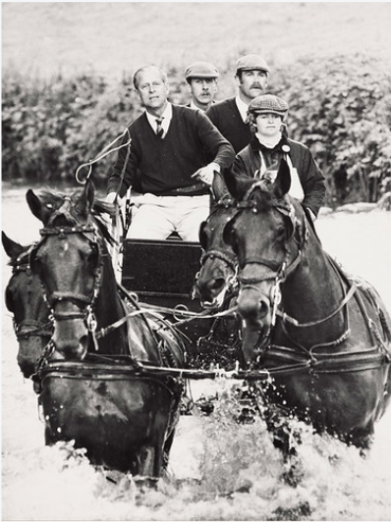
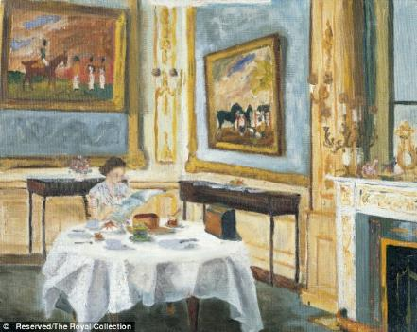
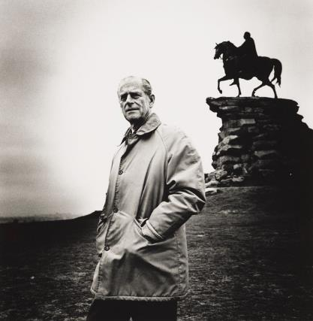
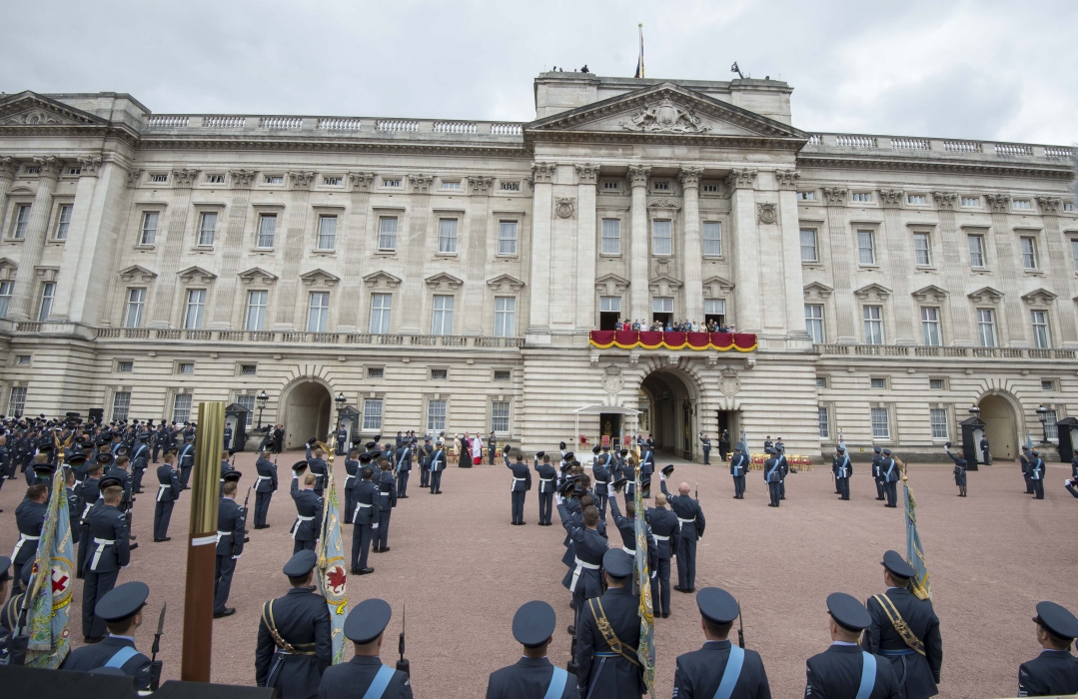
Less well-known facts…
Notes:
Slide 14: A few other things you might not know about Prince Philip [click to animate each picture]:
He loved carriage driving (especially at high speed!) through the countryside, and competed internationally
With his love of engineering, he modernised Buckingham Palace
He was Ranger of Windsor Great Park and was instrumental in ensuring the upkeep of vast parklands, from designing gardens to introducing deer
He was a keen oil painter, and painted a portrait of his wife eating breakfast in Buckingham Palace
He was the first member of the Royal family to fly out of Buckingham Palace Gardens in a helicopter

Slide 14
Announcing his retirement
4th May 2017
On his retirement, aged 96, a guest at St. James’ Palace said ‘I'm sorry to hear that you're standing down.’ to which the Duke replied 'Well, I can't stand up for much longer!’
Notes:
Slide 15: During his lifetime, he was famous for his quick wit (and sometimes inappropriate comments!) On the day of his retirement, he attended a ceremony at St. James’ Palace. A guest at the reception said to him ‘I'm sorry to hear that you're standing down.’ to which he replied 'Well, I can't stand up for much longer!’

Slide 15
HRH Prince Philip, Duke of Edinburgh
1921 - 2021
Notes:
Slide 16: Losing someone is hard – there’s no doubt about that. Although the Duke of Edinburgh was a very great man, who lived a full and fulfilled life, we also need to remember that he was also a husband, father, uncle, grandfather and great-grandfather, who will be missed by the family who loved him.

Slide 16
‘I will be with you always – until the very end of time.’
(Matthew 28:20)
Notes:
NB Choose the correct version
Slide 17: But it’s also good to remember that because the Queen is a Christian, she will be drawing strength from God whom she has faithfully served during her long reign and holding tight to the promise that Jesus makes to all his followers: ‘I will be with you always – until the very end of time.’ (Matthew 28:20) And we can pray for her and her family, as many Christians all over the world will also be doing at this sad time.
Slide 17: Many members of the Royal Family will be drawing strength from God at this sad time and holding tight to the promise that Jesus makes to all his followers: ‘I will be with you always – until the very end of time.’ (Matthew 28:20) And we can pray for them, as many Christians all over the world will also be doing at this sad time.

Slide 17
The Lord's my shepherd, I'll not want; He makes me down to lie In pastures green; he leadeth me The quiet waters by. My soul he doth restore again, And me to walk doth make Within the paths of righteousness, E'en for his own name's sake. Yea, though I walk in death's dark vale, Yet will I fear no ill: For thou art with me, and thy rod And staff me comfort still. My table thou hast furnished In presence of my foes; My head thou dost with oil anoint And my cup overflows. Goodness and mercy all my life Shall surely follow me; And in God's house for evermore My dwelling-place shall be

